Slide 1
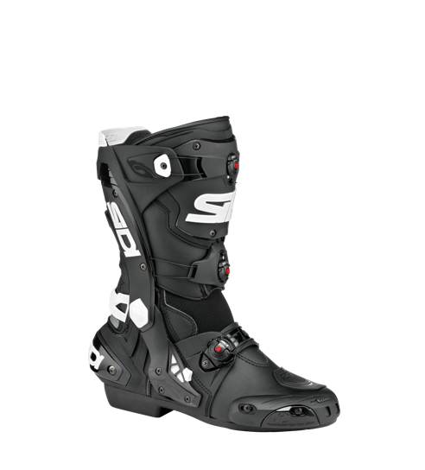
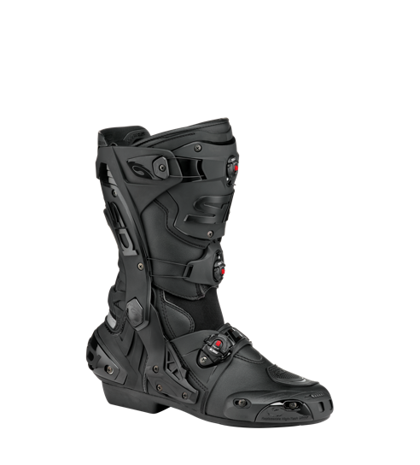
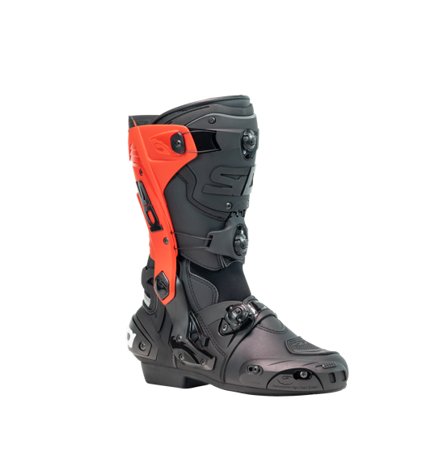
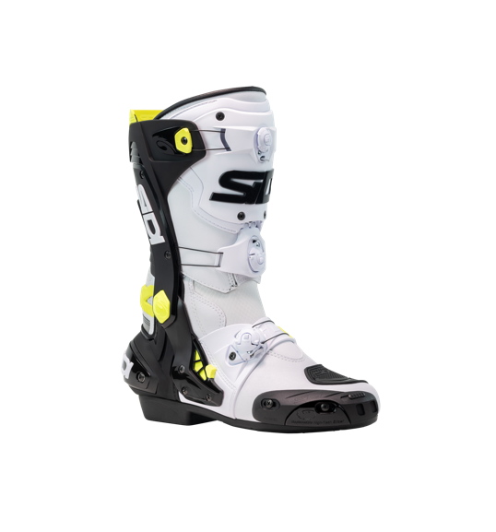
REX 479,95 € TTC
CARRY OVER
000MVREX
BLACK - WHITE
BLACK
NEW
WHITE BLACK YELLOW
BLACK - RED

Slide 2
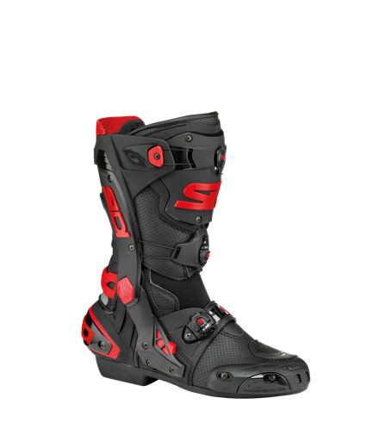
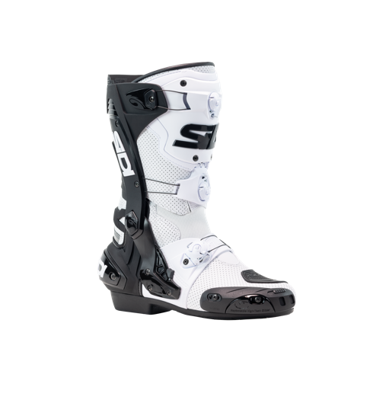
REX AIR 479,95 € TTC
CARRY OVER
000MVREXAIR
BLACK - RED
NEW
WHITE – BLACK

Slide 3
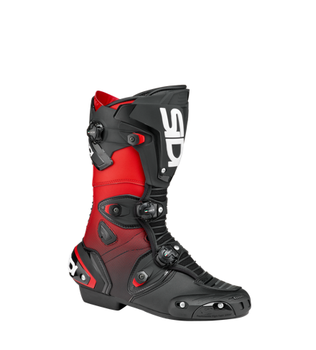
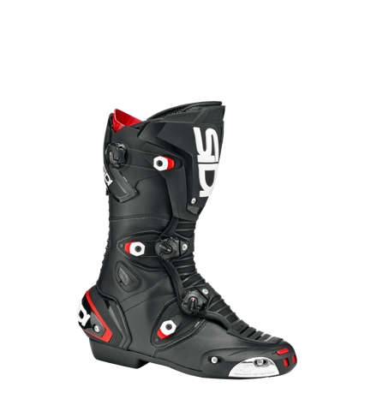
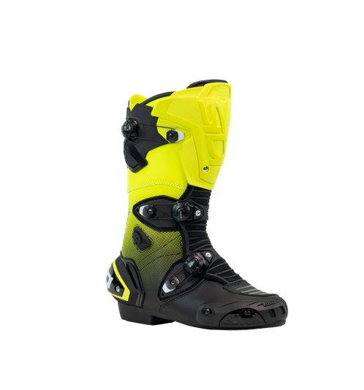
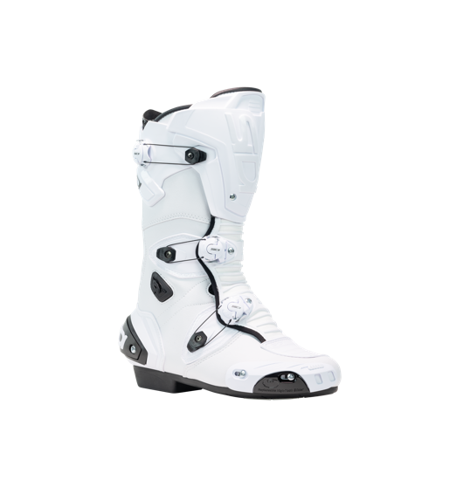
MAG-1 429,95 € TTC
CARRY OVER
000MVMAG1
BLACK - RED
BLACK - BLACK
NEW
BLACK - YELLOW
WHITE - WHITE

Slide 4
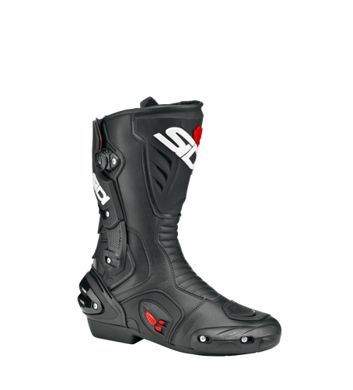
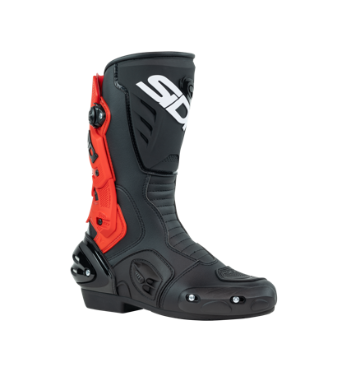
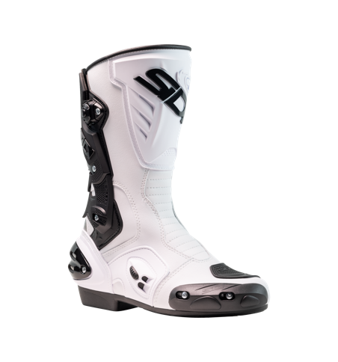
VERTIGO II 349,95 € TTC
CARRY OVER
000MVVERTIGO2
BLACK - BLACK
NEW
BLACK - RED
WHITE - BLACK

Slide 5
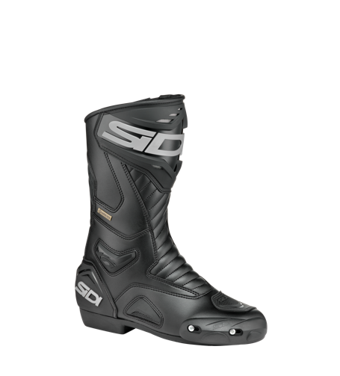
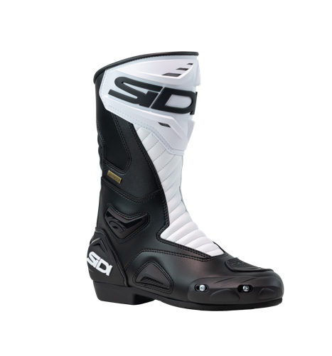
PERFORMER GORE 329,95 € TTC
CARRY OVER
000MVPERFORMERGO
BLACK - BLACK
NEW
WHITE - BLACK

Slide 6
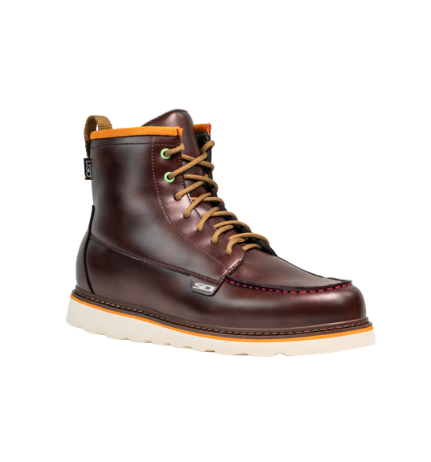
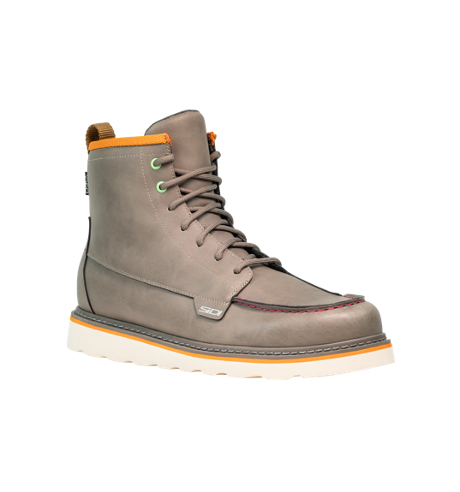
URBEX 259,95 € TTC
000MPURBEXWP
BURGUNDY
GRAY

Slide 8
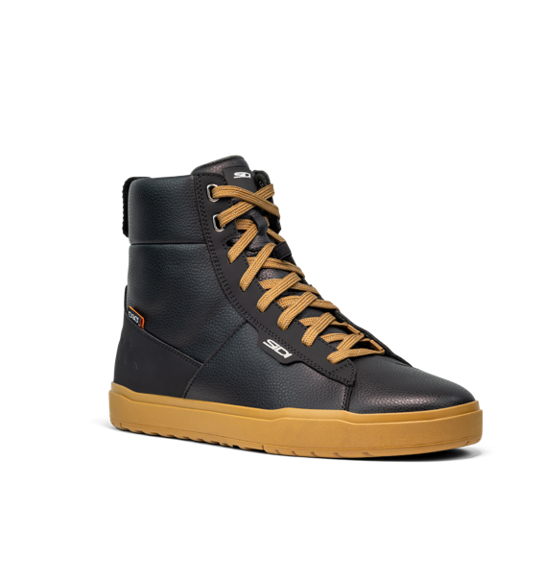
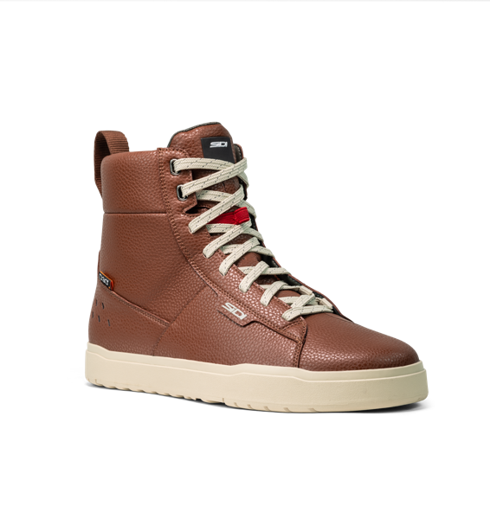
ARX HIGH 249,95 € TTC
000MPARXHIGHWP
BLACK
CINNAMON

Slide 9
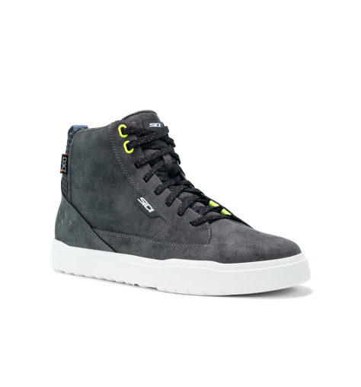
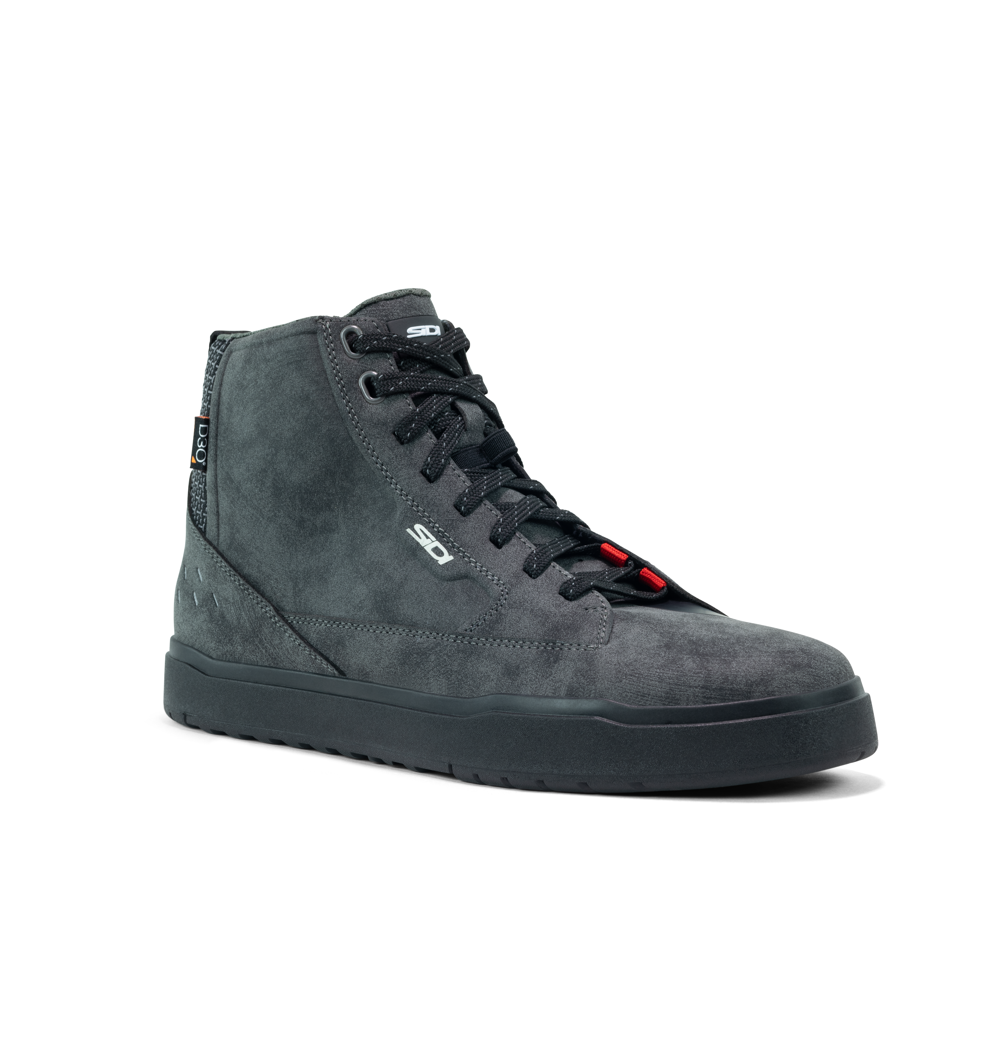
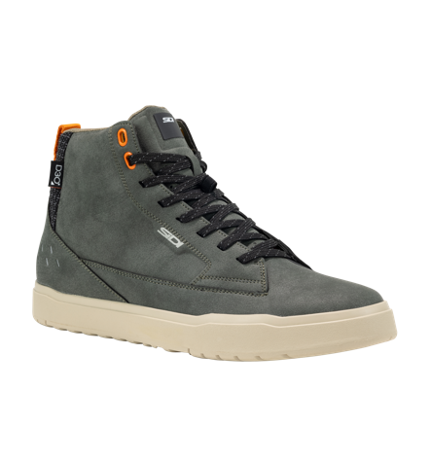
ARX WP 218,95 € TTC
CARRY OVER
00MARXWP
BLACK - WHITE
FULL BLACK
IVY CASTLE

Slide 10
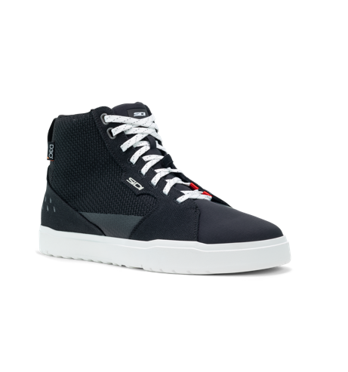
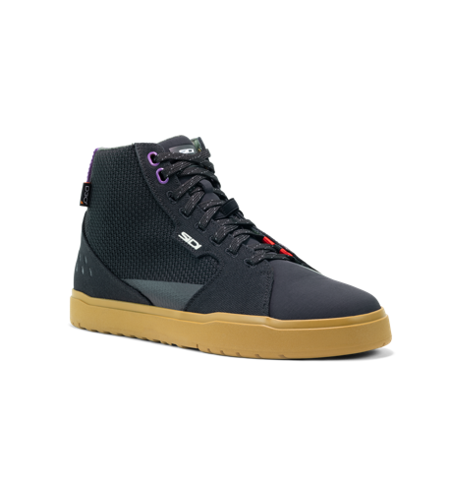
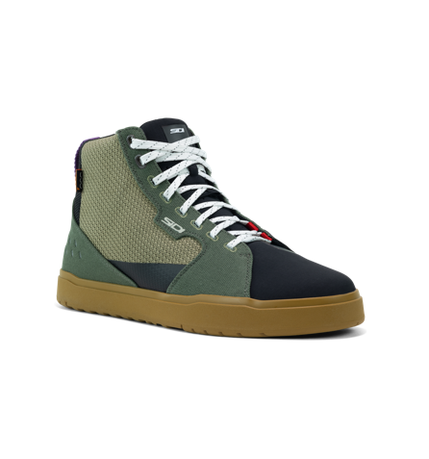
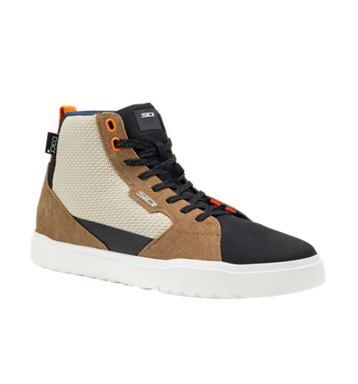
ARX AIR 196,95 € TTC
CARRY OVER
000MARXAIR
CASTAIN - BRONZE
BLACK - WHITE
BLACK - BRONZE
LEMON IVY BRONZE

Slide 11
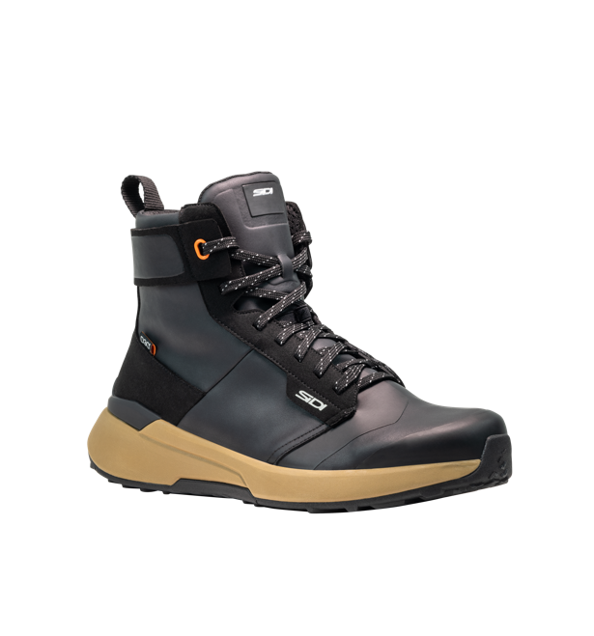
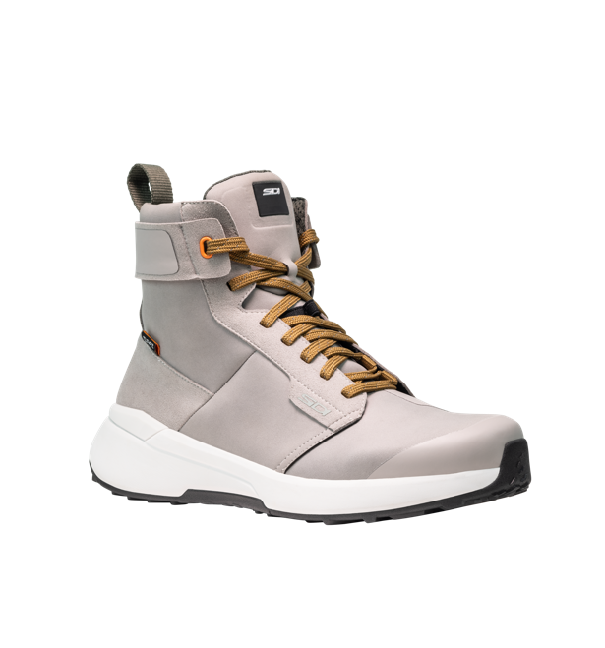
NUCLEUS HIGH 249,95 € TTC
000MPNUCLEUSHIGHWP
BLACK
GRAY

Slide 12
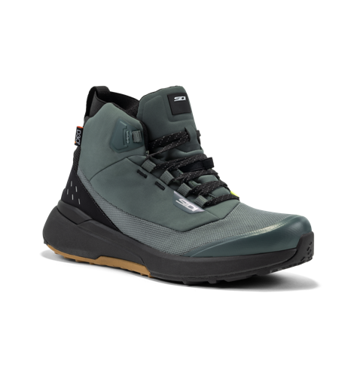
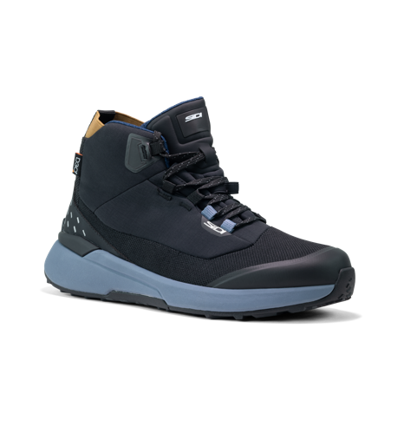
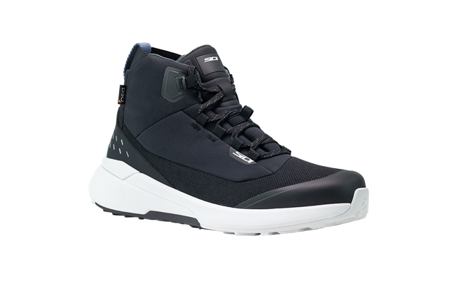
NUCLEUS GTX 239,95 € TTC
CARRY OVER
000MNUCLEUSGTX
IVY - BLACK
BLACK – BERING SEA
BLACK - WHITE

Slide 13
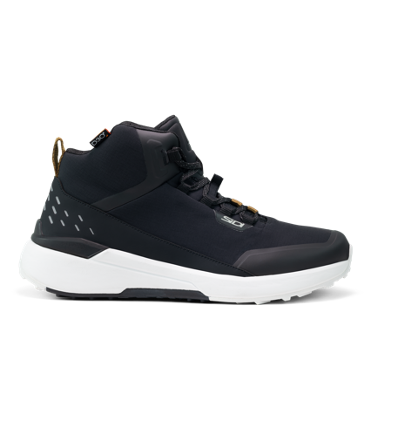
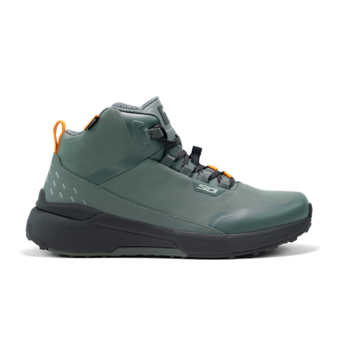
NUCLEUS 207,95 € TTC
CARRY OVER
000MNUCLEUS
LEMON – BLACK
BLACK - WHITE
IVY - BLACK

