Slide 2
GOVERNANCE
23 entrepreneurs (VNW shareholders)
owns
10%
own
90%
- R&D e-bikes, motorcycles, e-mobility
- MFTG e-bikes
owns
80%
owns
100%
owns
100%
- R&D bikes,
- MFTG bikes
- R&D in Fantic,
- MFTG in Fantic
owns 20%
- R&D PCBs, batteries
- MFTG PCBs, batteries
- R&D IC engines and e-DU
- MFTG IC engines, e-DU and motorcycles

Slide 3
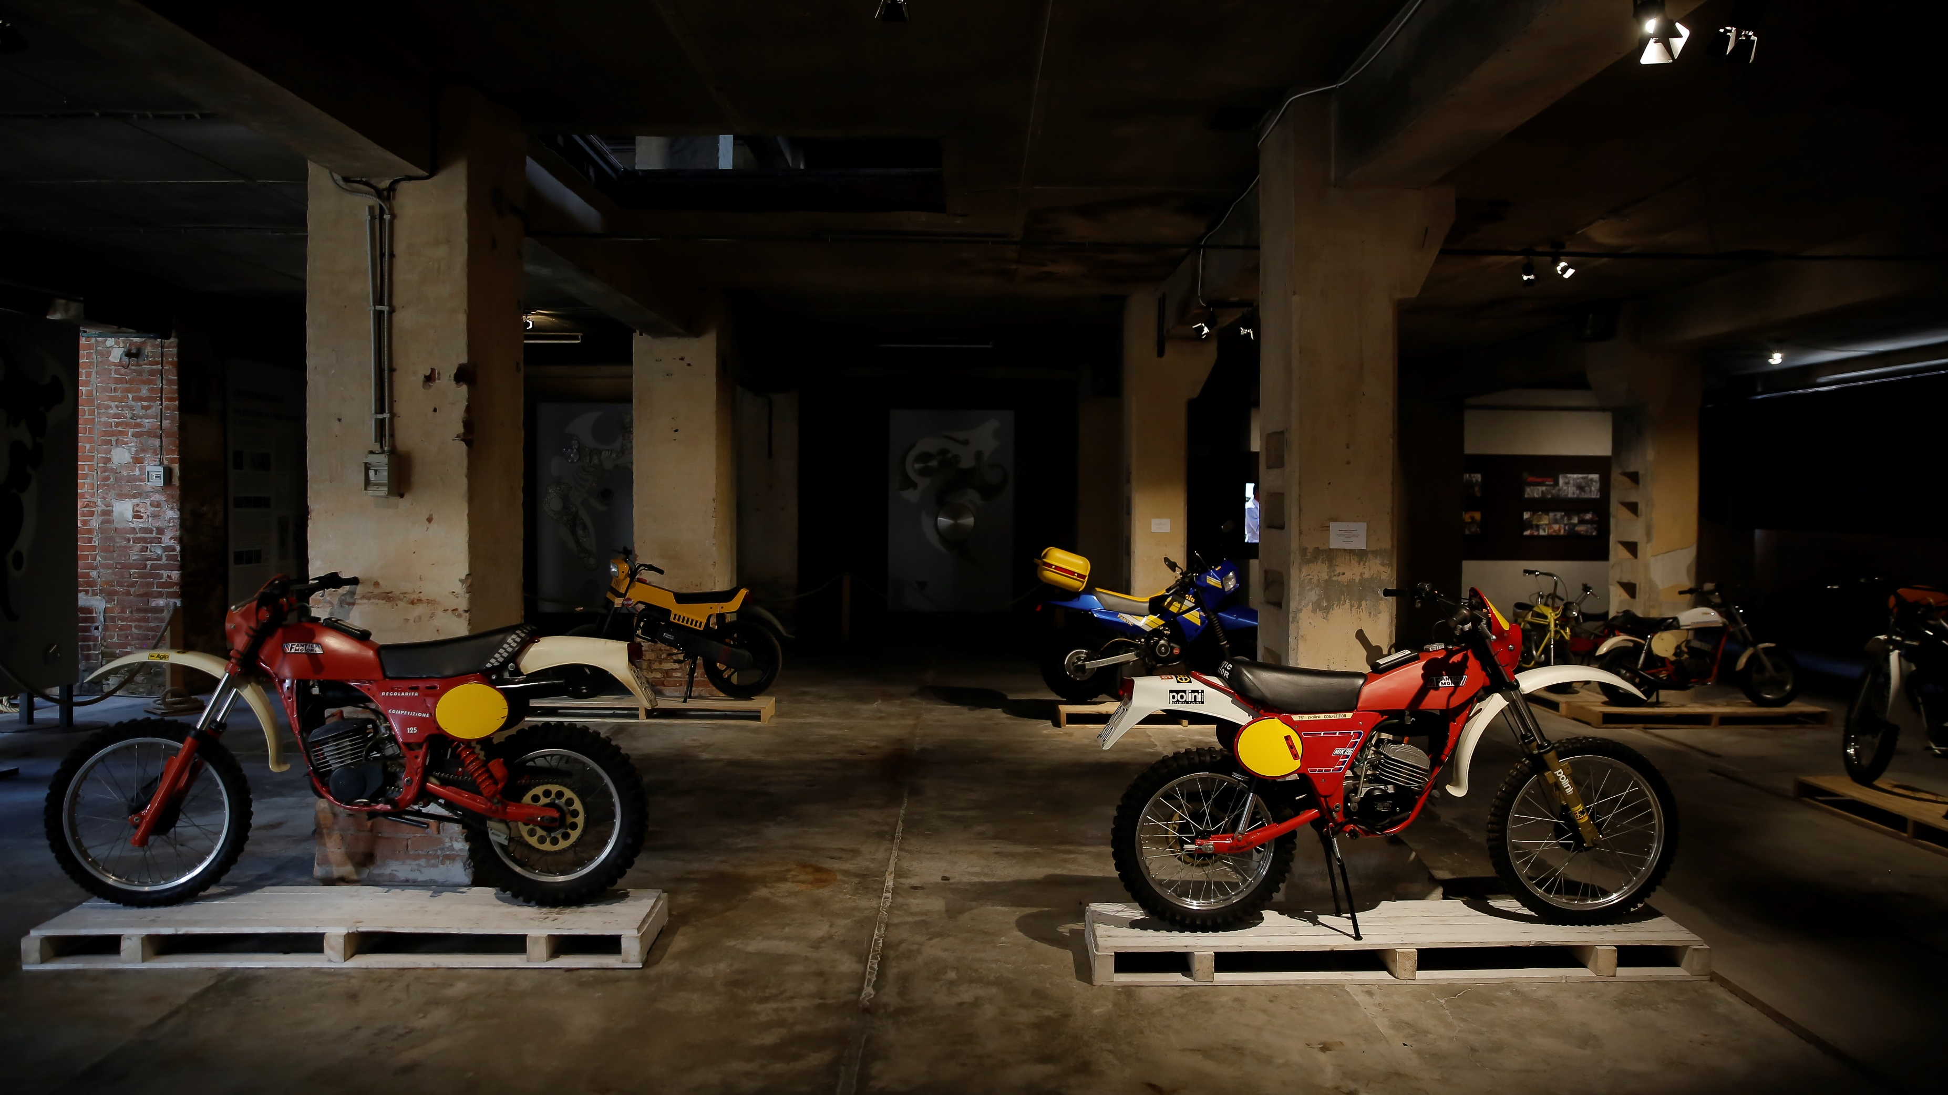

Slide 4
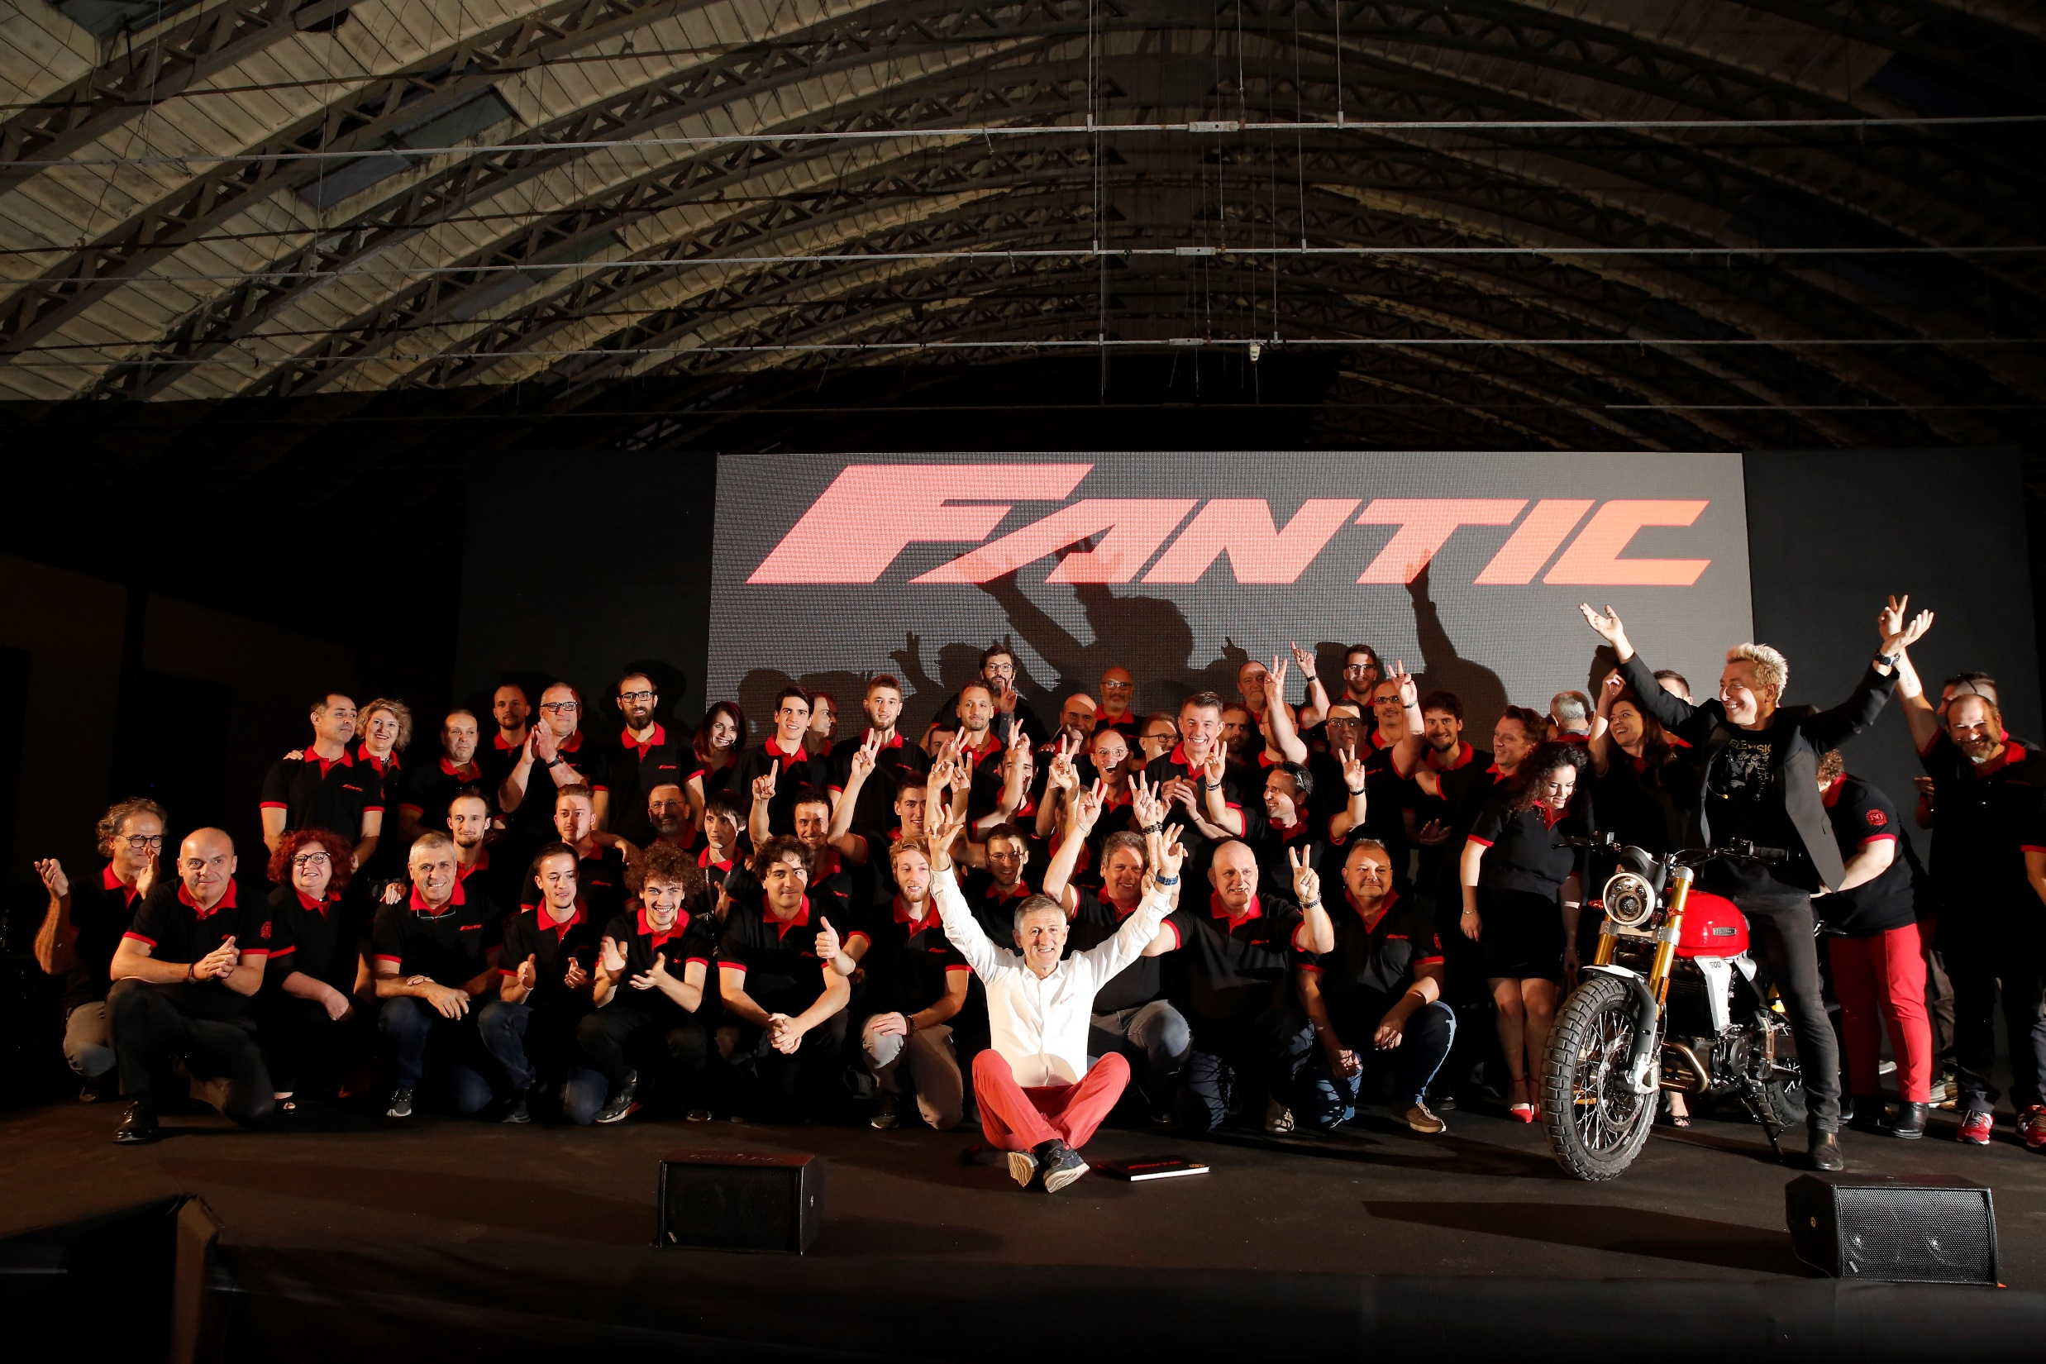
2014-2022:
FROM 6 TO 500 TALENTS
FROM A TURNOVER OF 0.8M€ TO 200M€
FROM 50-125cc MOTORCYCLES TO 4 DIFFERENT PILLARS

Slide 5
ANNUAL TURNOVER
TARGET 2022 WAS 5 TIMES 2020 RESULT
ACHIEVEMENT OF ITALIAN INVESTMENTS AND TALENTS

Slide 6
SHAPING EMOTIONS ACROSS ALL MOBILITY WORLDS
MOTORBIKES
POWERTRAIN
ENGINEERING
BIKES
eMOBILITY
XE/XM
50/125
CONCETTI PER IL PARLATO: questa crescita fa sì che ormai Fantic abbia un’impronta importante in tutti i settori della mobilità. Siamo l’unica azienda 100% Italiana a coprire con prodotti tecnologici e innovativi tutto il mercato

Slide 7
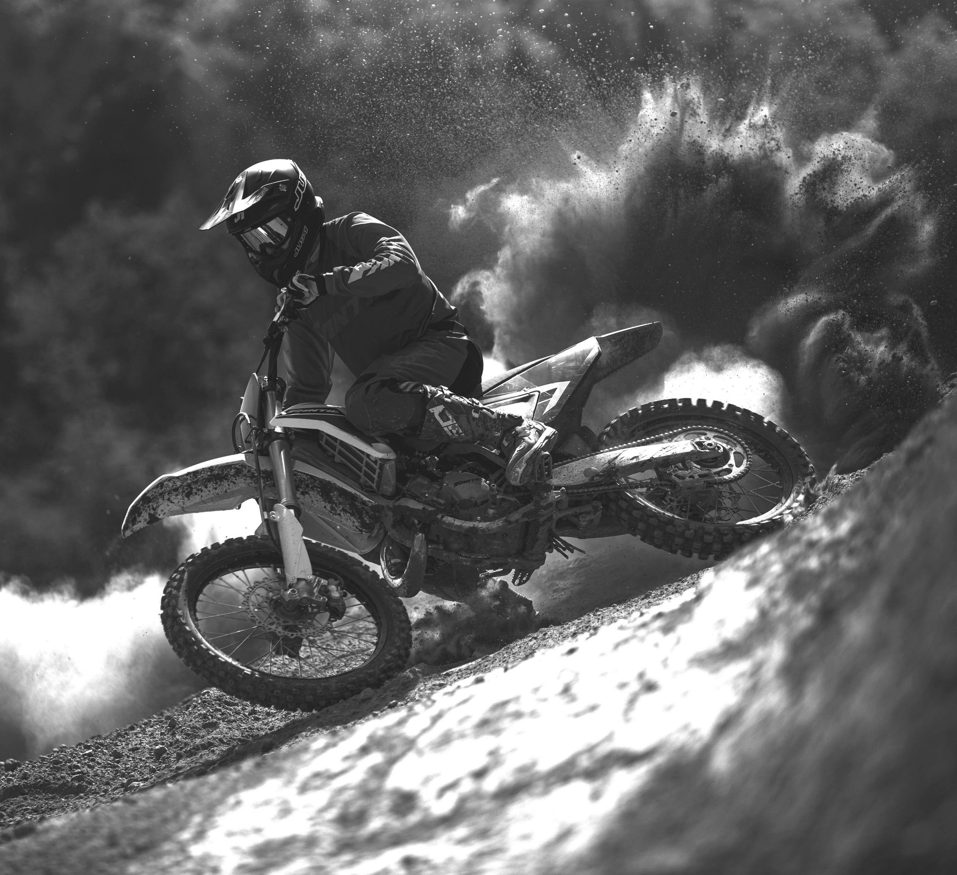
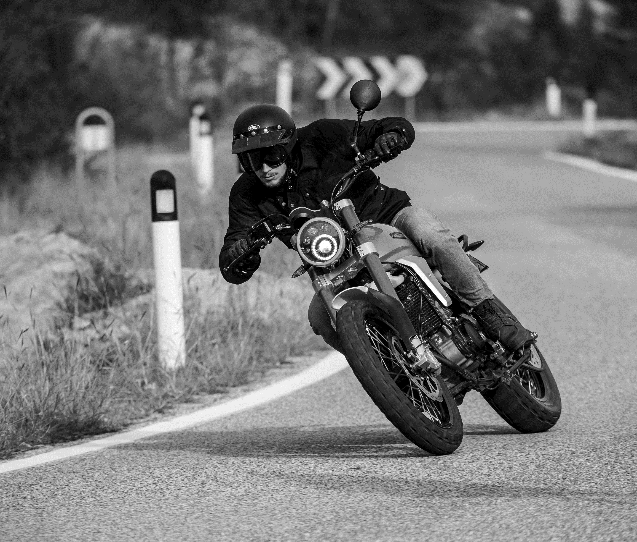
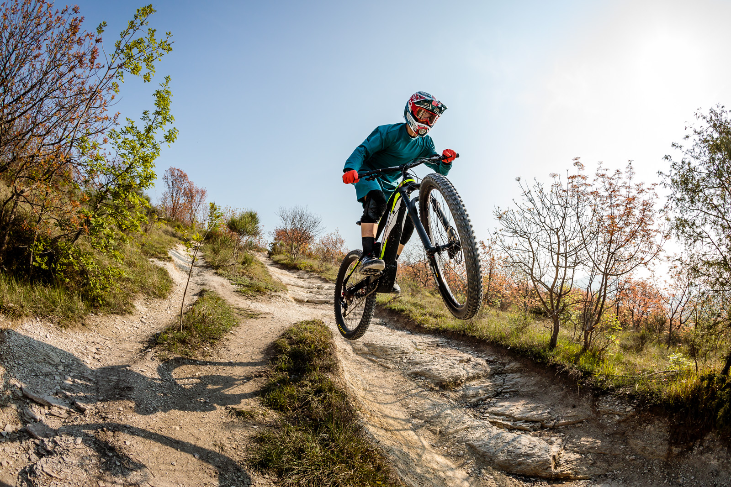
CABALLERO
OFFROAD
E-BIKES
E-MOBILITY

Slide 8
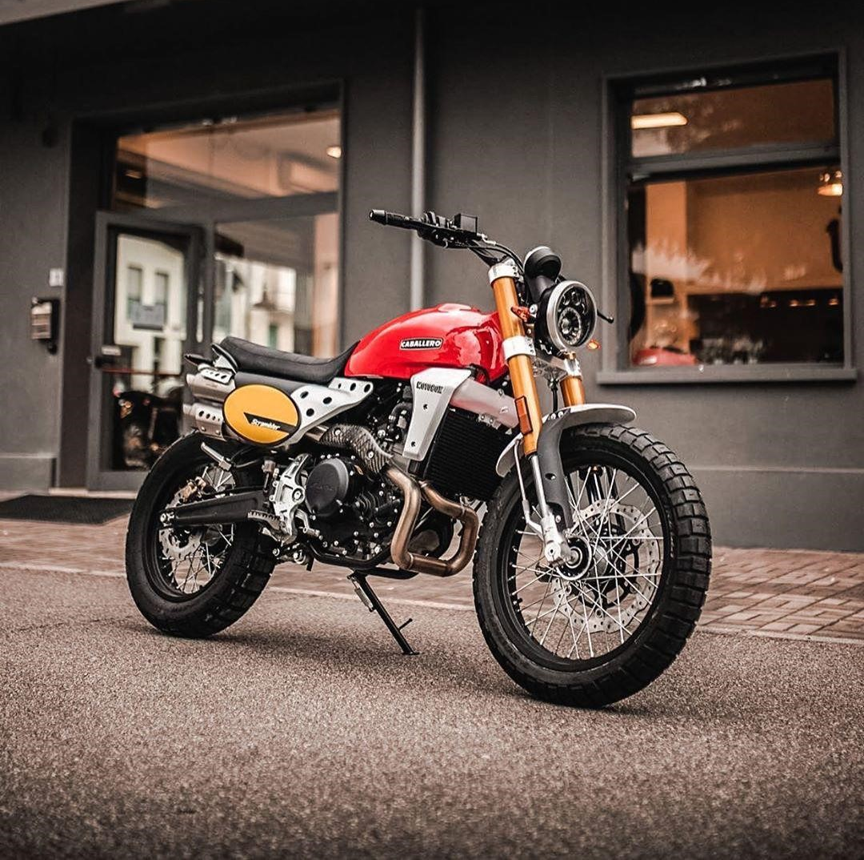
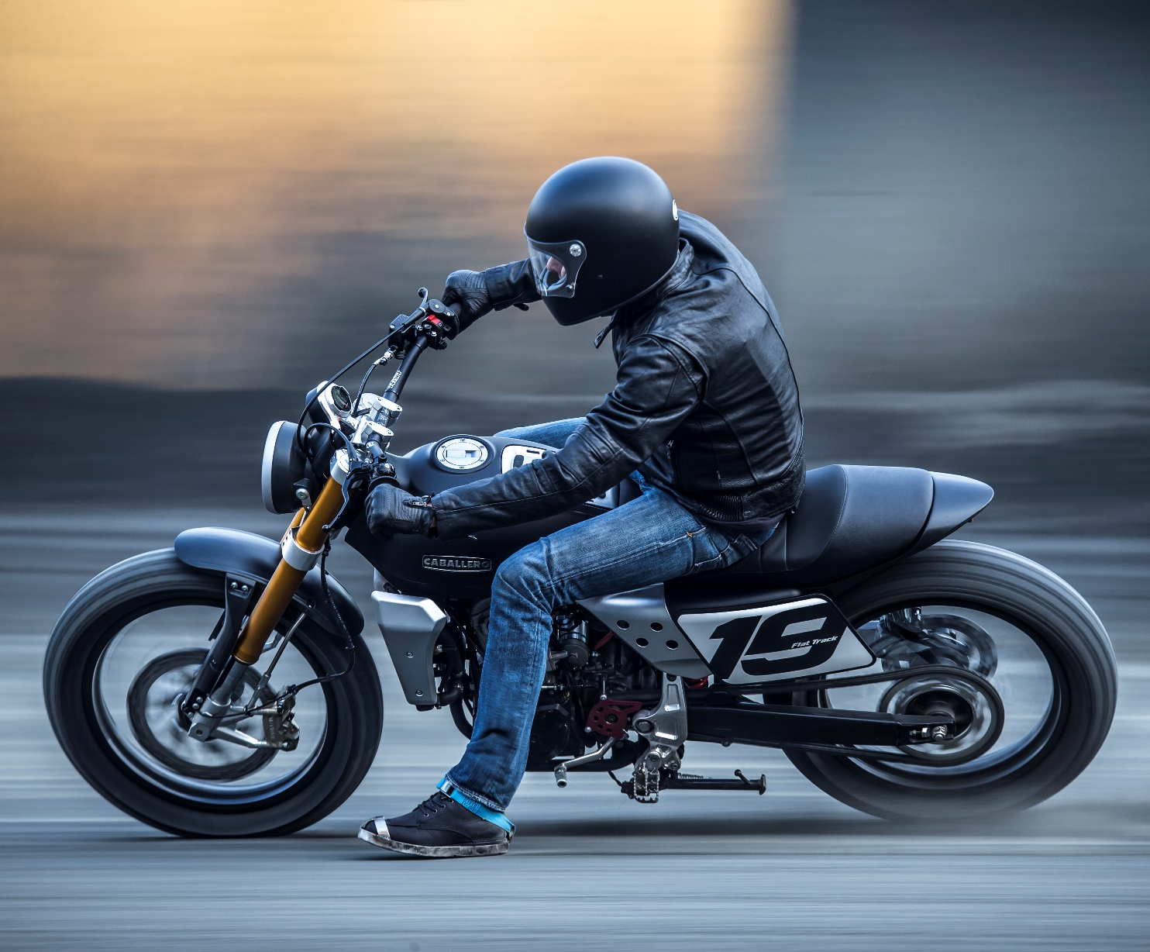
Notes:
Scrambler version (Modern Classic)
Dirt Track version: innovative interpretation of old US Flat Track motorcycles (Indian and Harley)

Slide 9
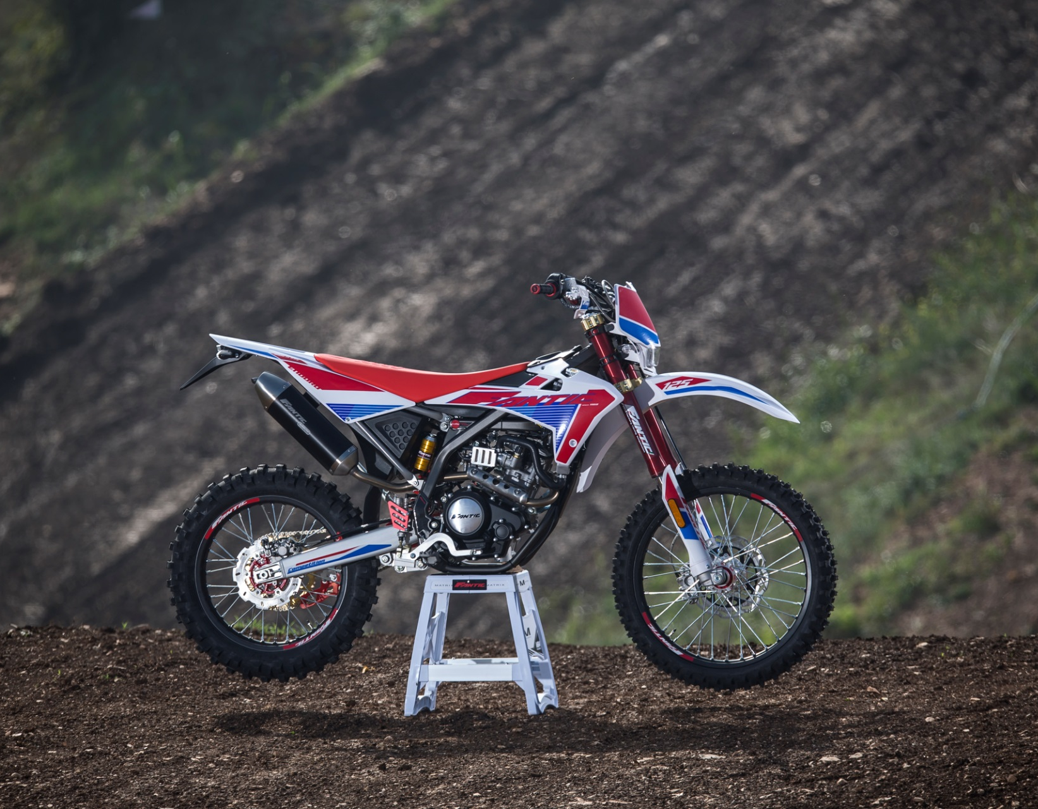
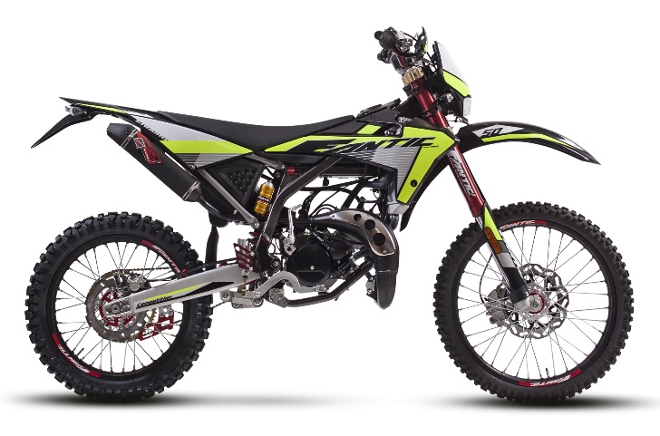
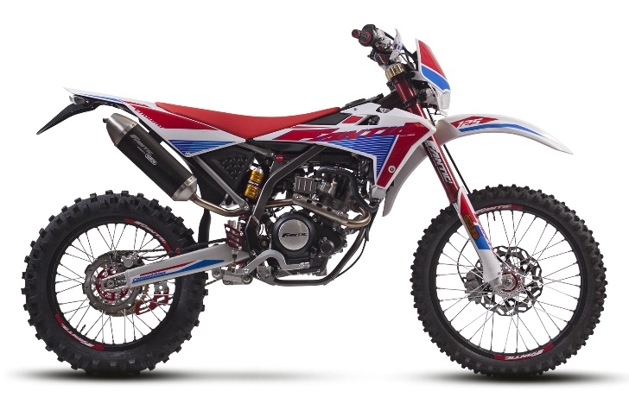
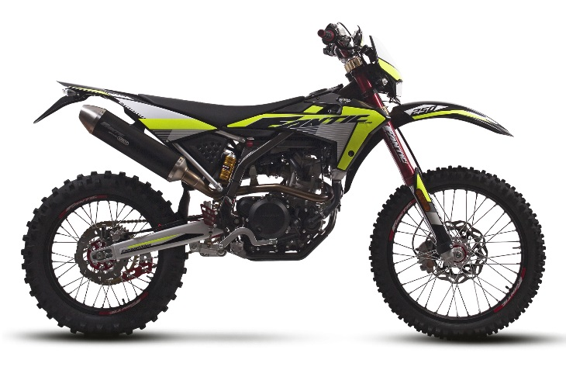
50cc
ENDURO LINE
2-stroke
125cc
4-stroke
250cc

Slide 10
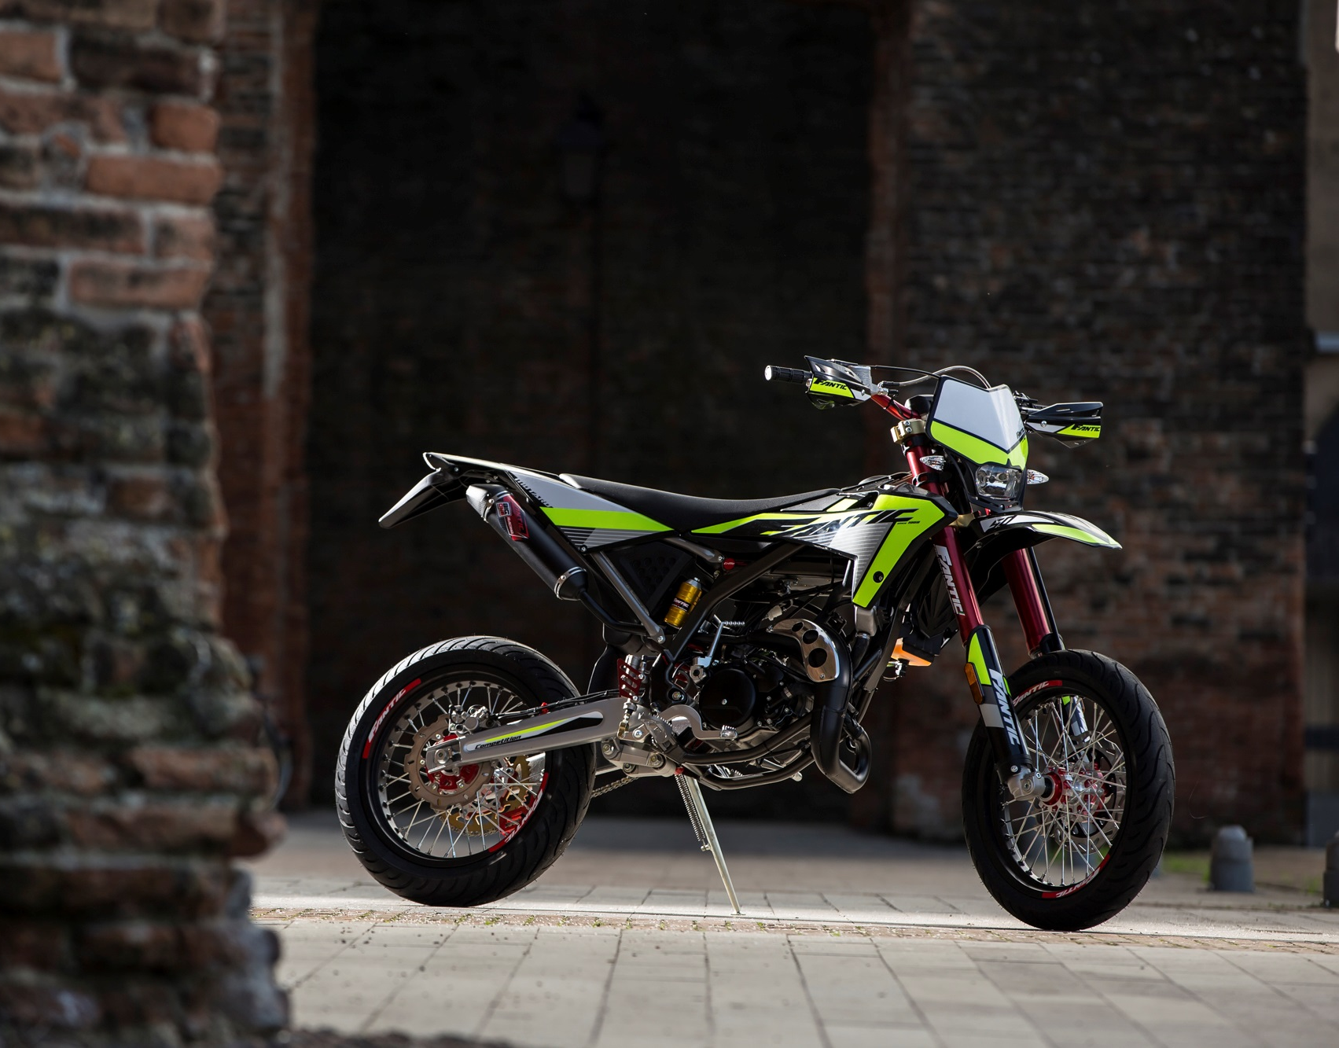
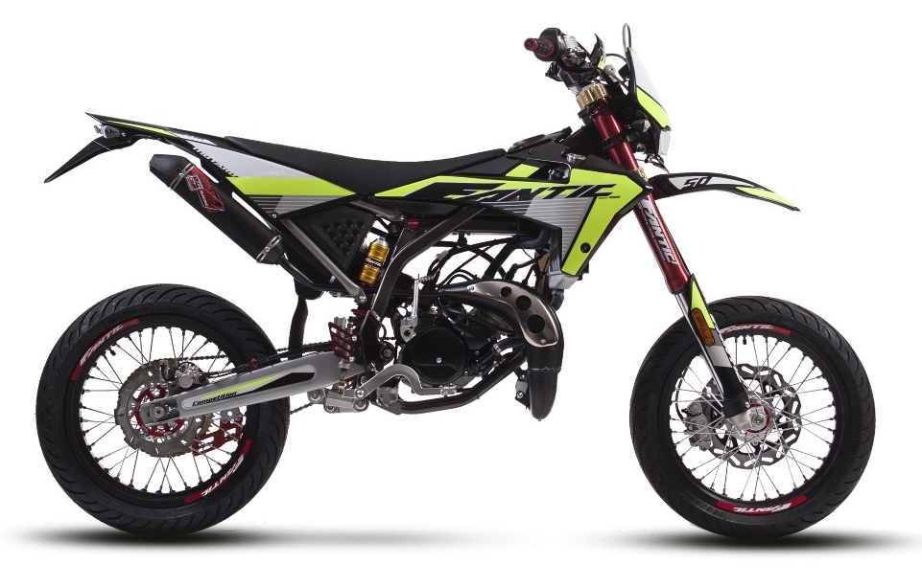
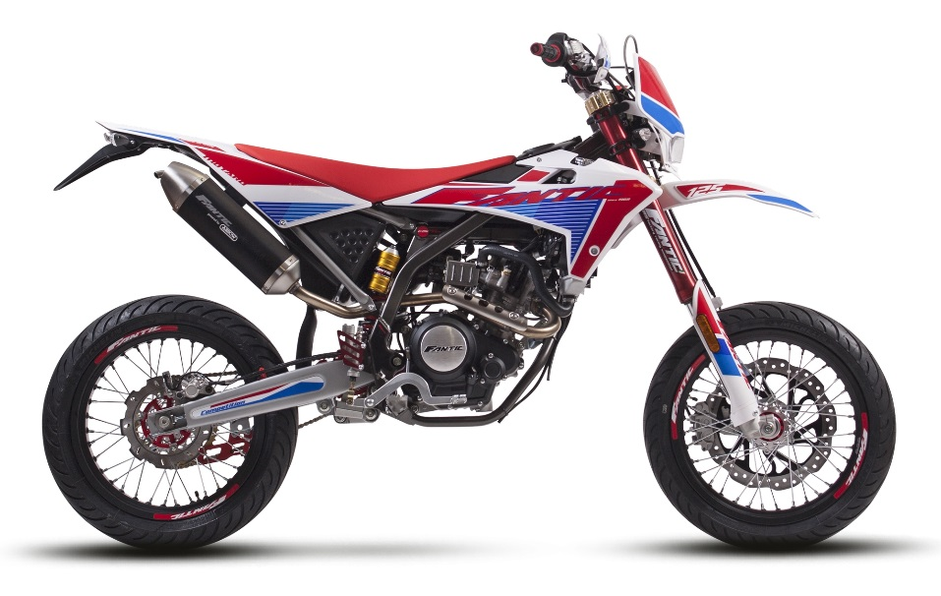
MOTARD LINE
50cc
2-stroke
125cc
4-stroke

Slide 11
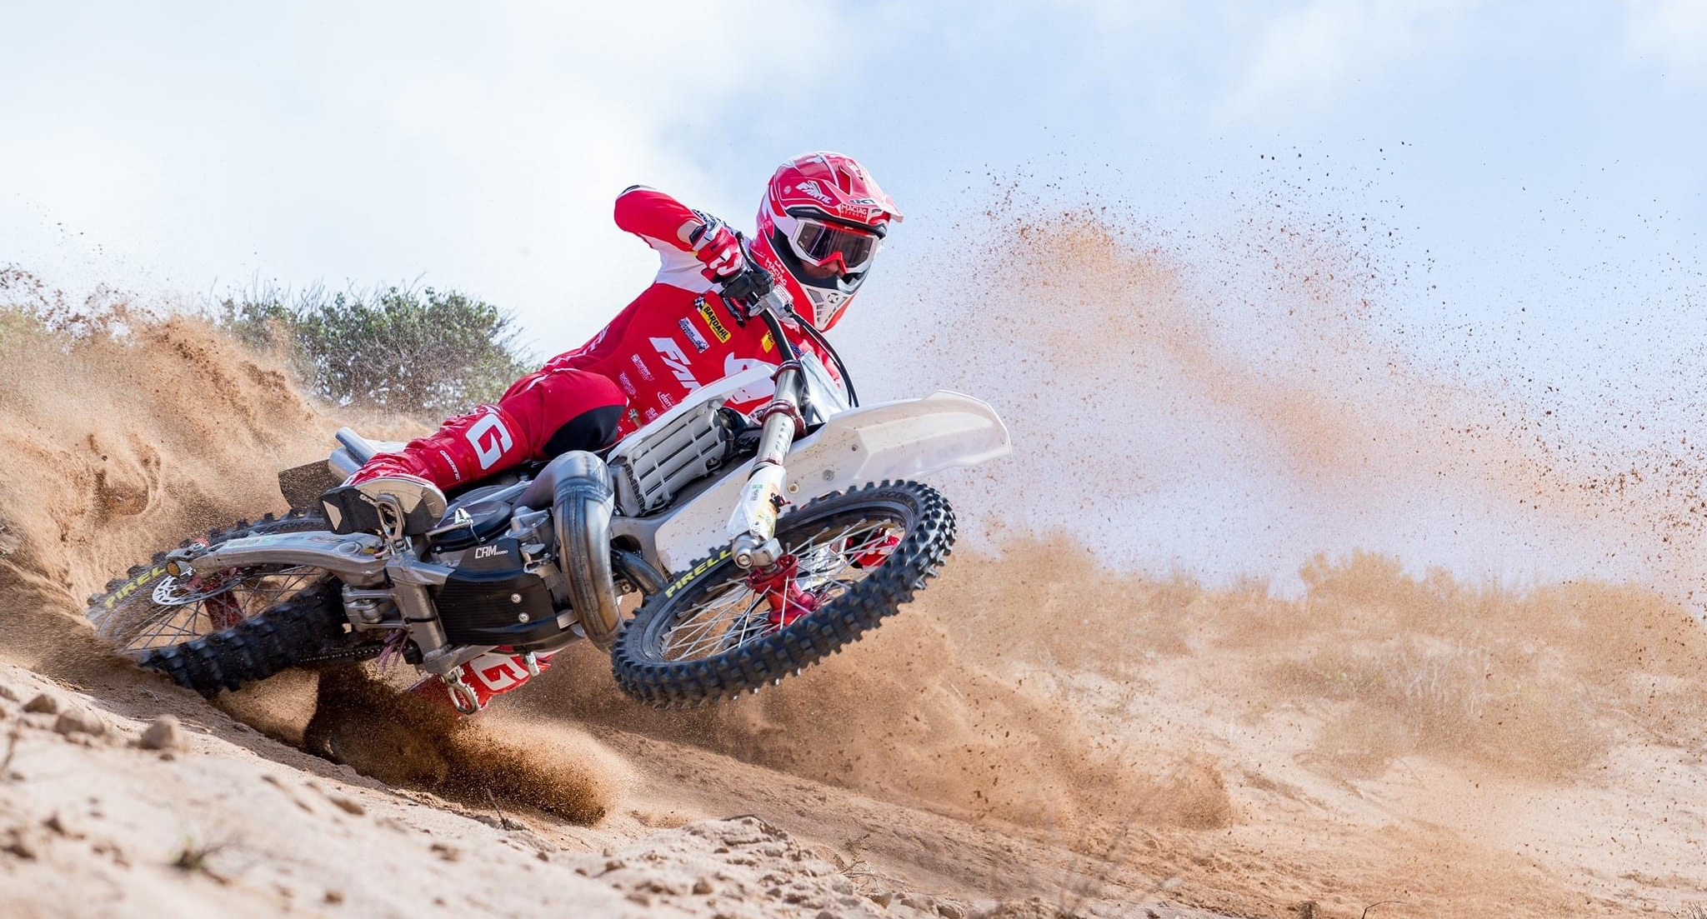
Motocross & Enduro from 125 to 450cc
2 strokes & 4 strokes

Slide 12
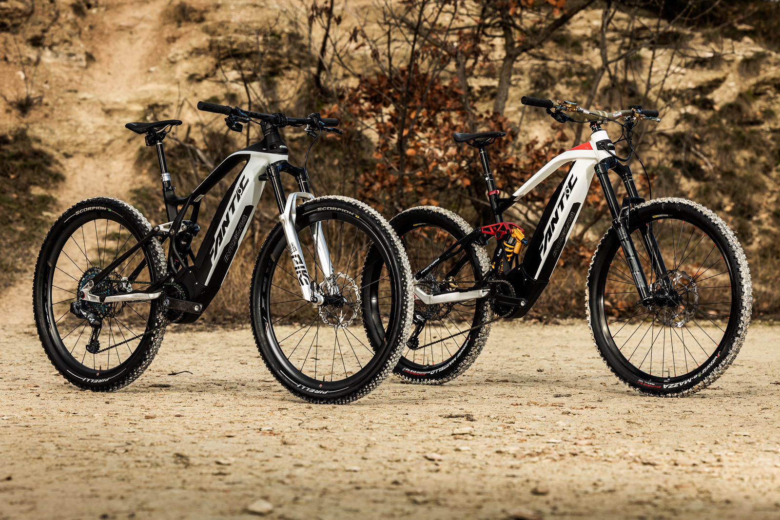
Full range of e-MTB:
DH
Enduro
All Mountain
Trail
Notes:
Voted by a European commission as the best Enduro e-bike of 2018

Slide 13
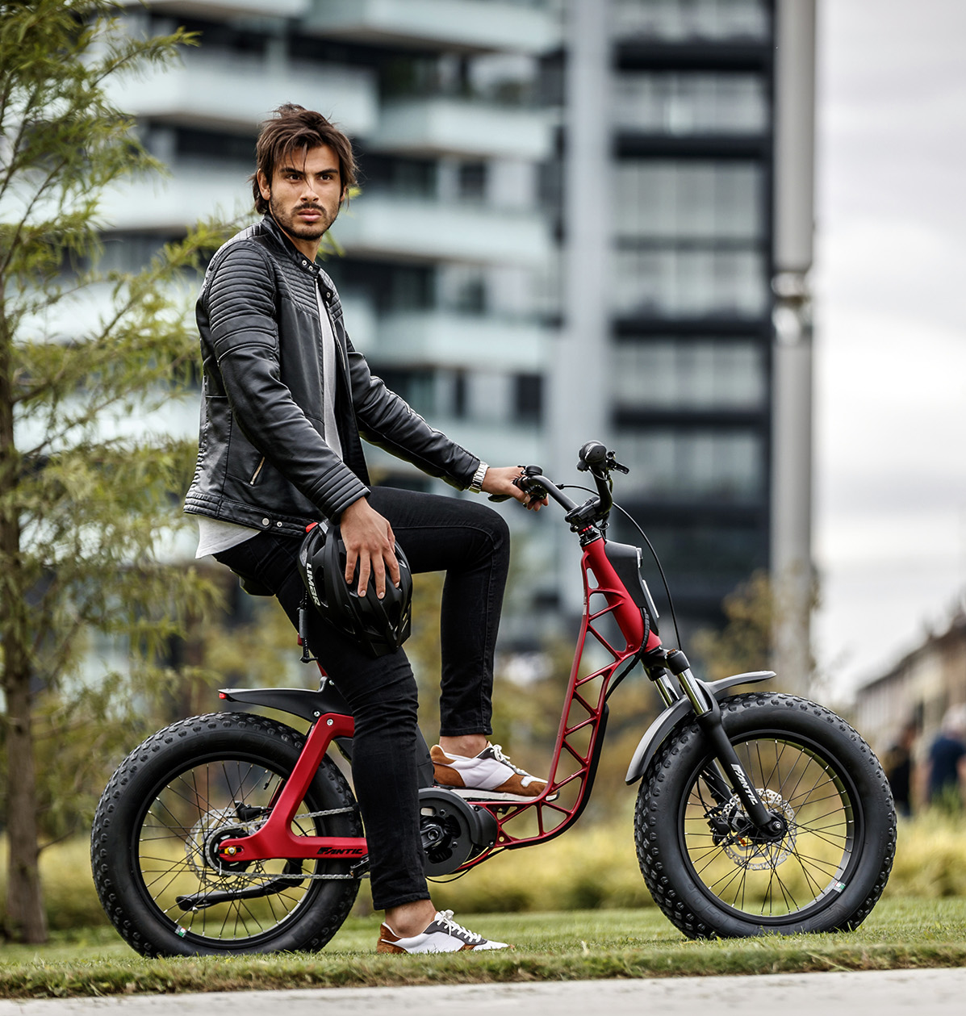
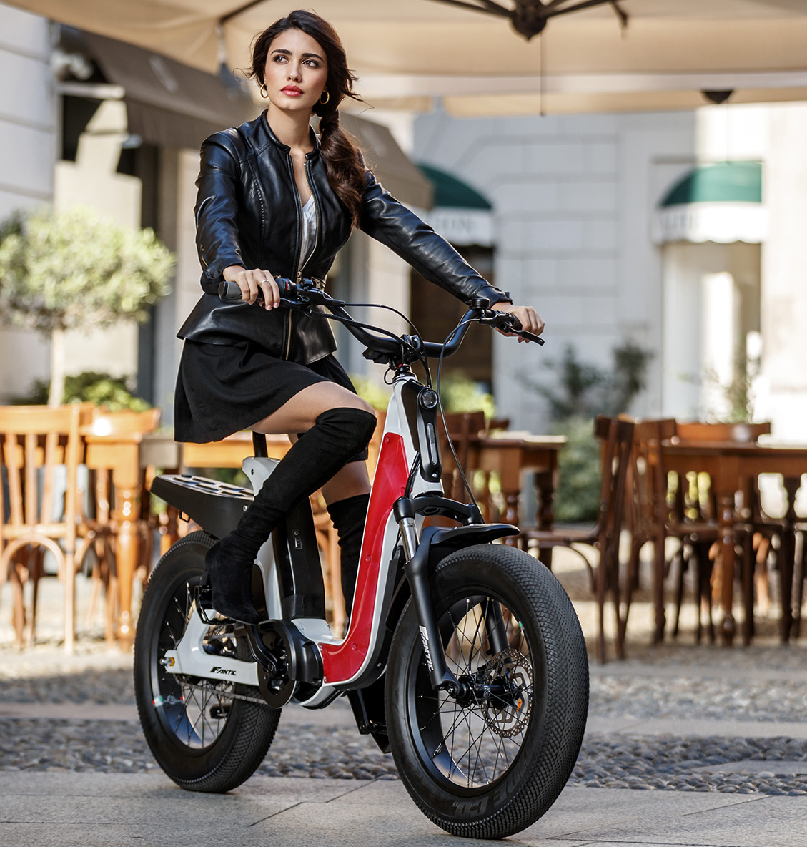

Slide 14
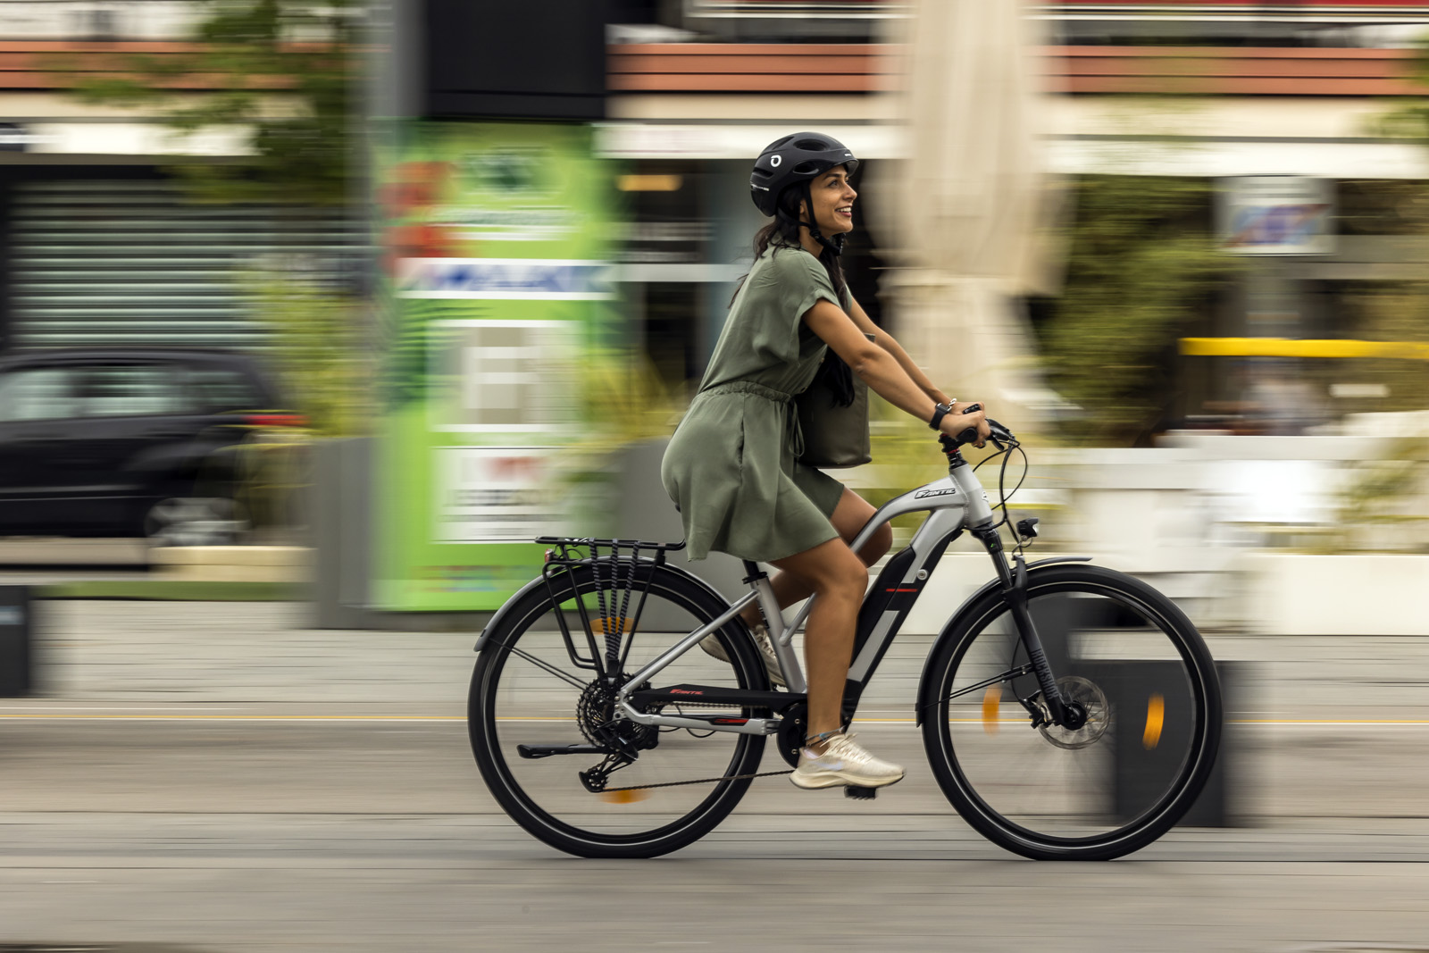
Full range of Trekking and
City e-bikes.
Notes:
Voted by a European commission as the best Enduro e-bike of 2018

Slide 15
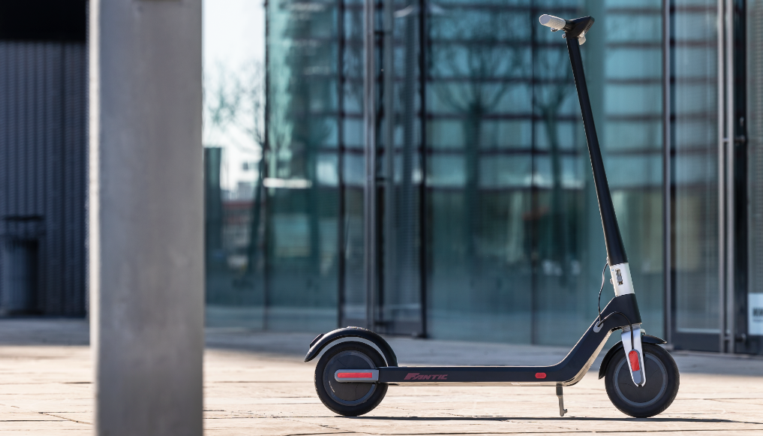
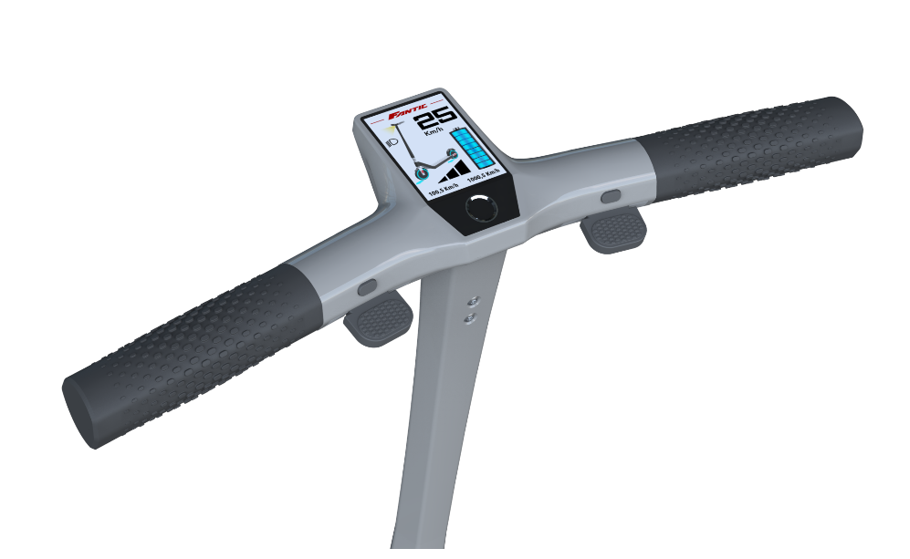
FANTIC
E-KICKSCOOTER

Slide 16
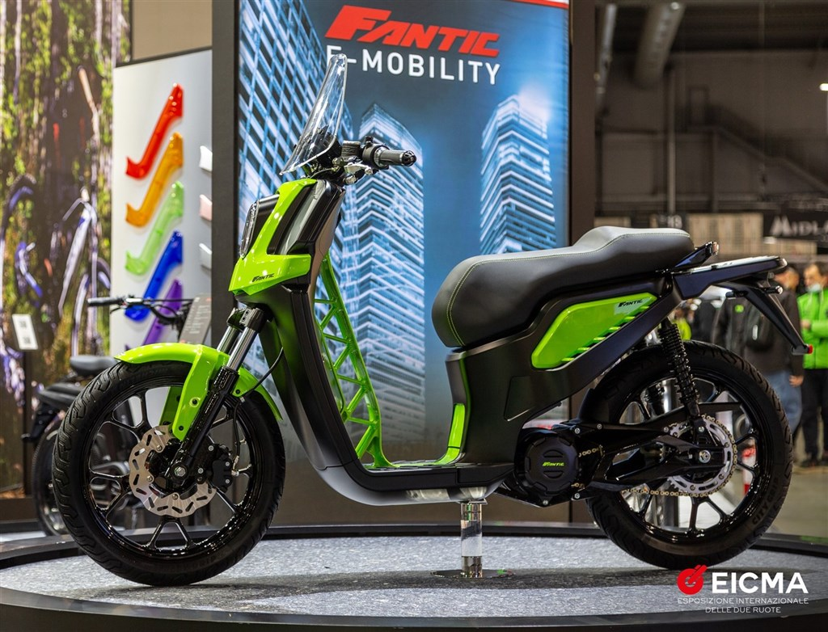
Fantic e-scooter
presented in
EICMA 2021.
Notes:
Voted by a European commission as the best Enduro e-bike of 2018

Slide 17
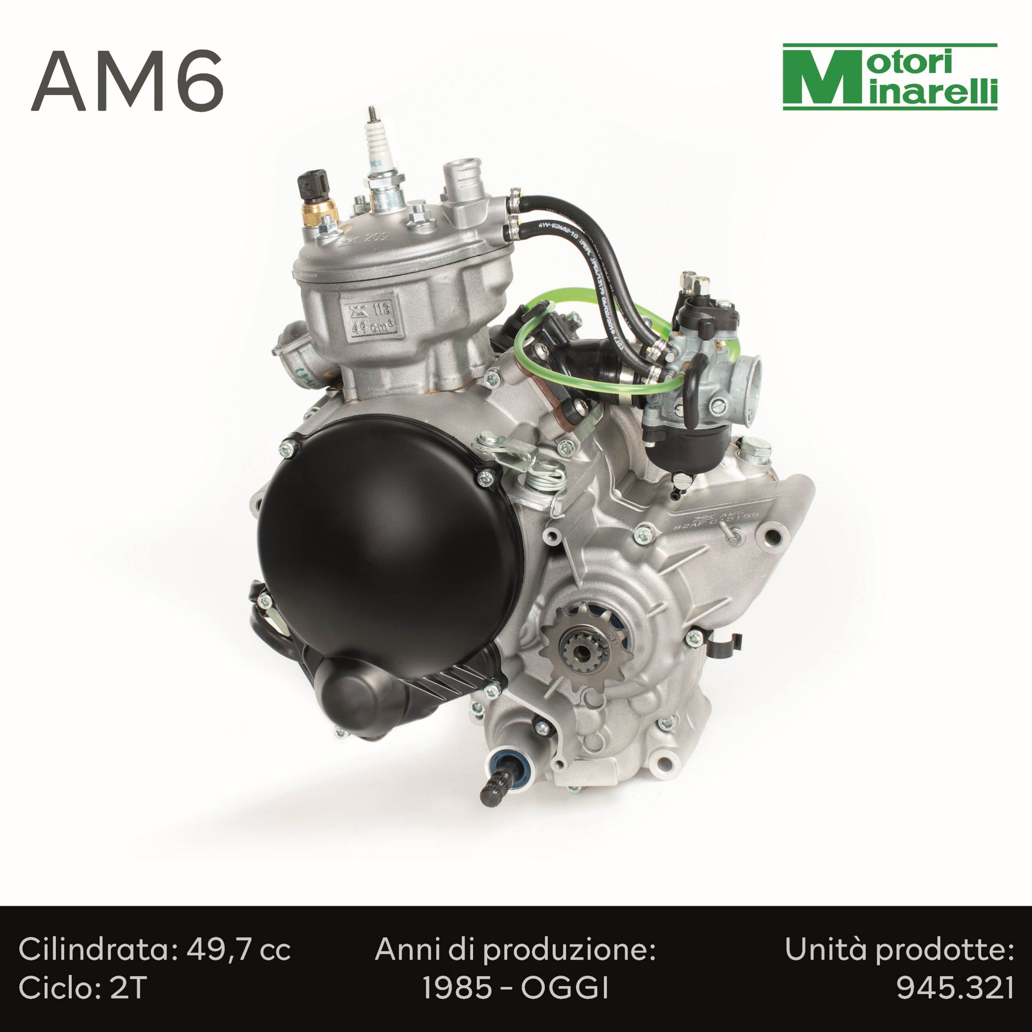
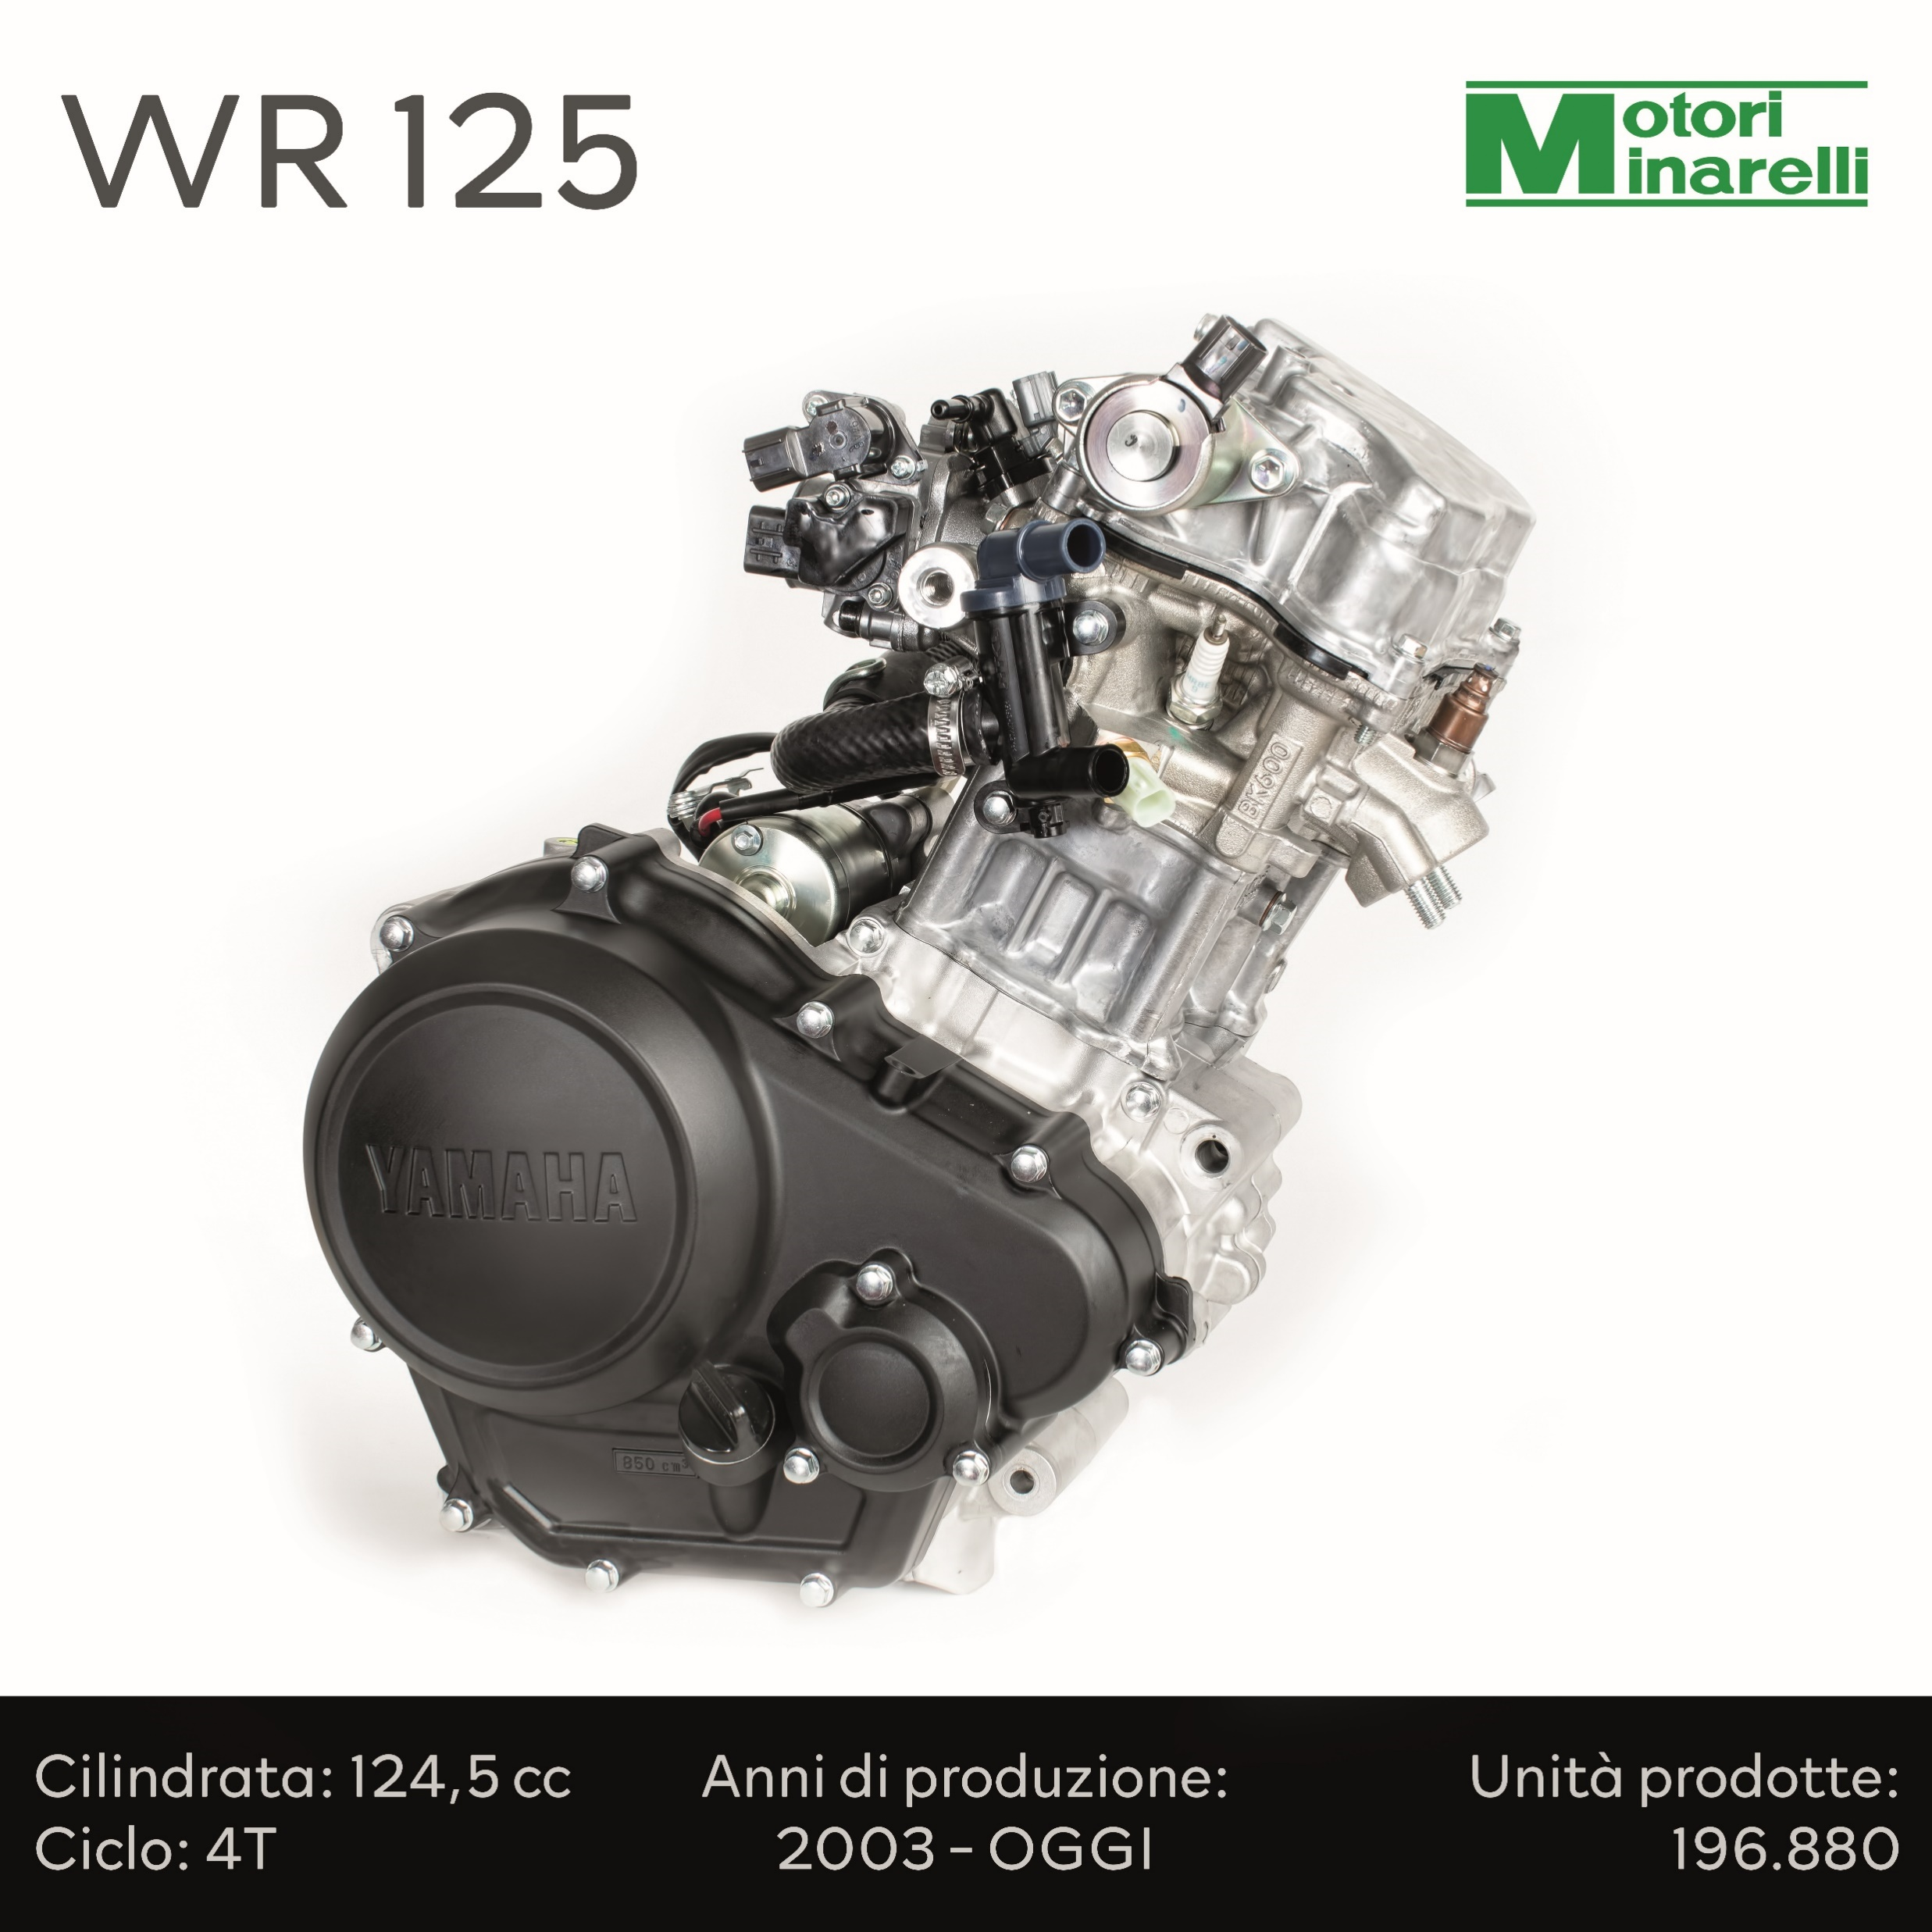
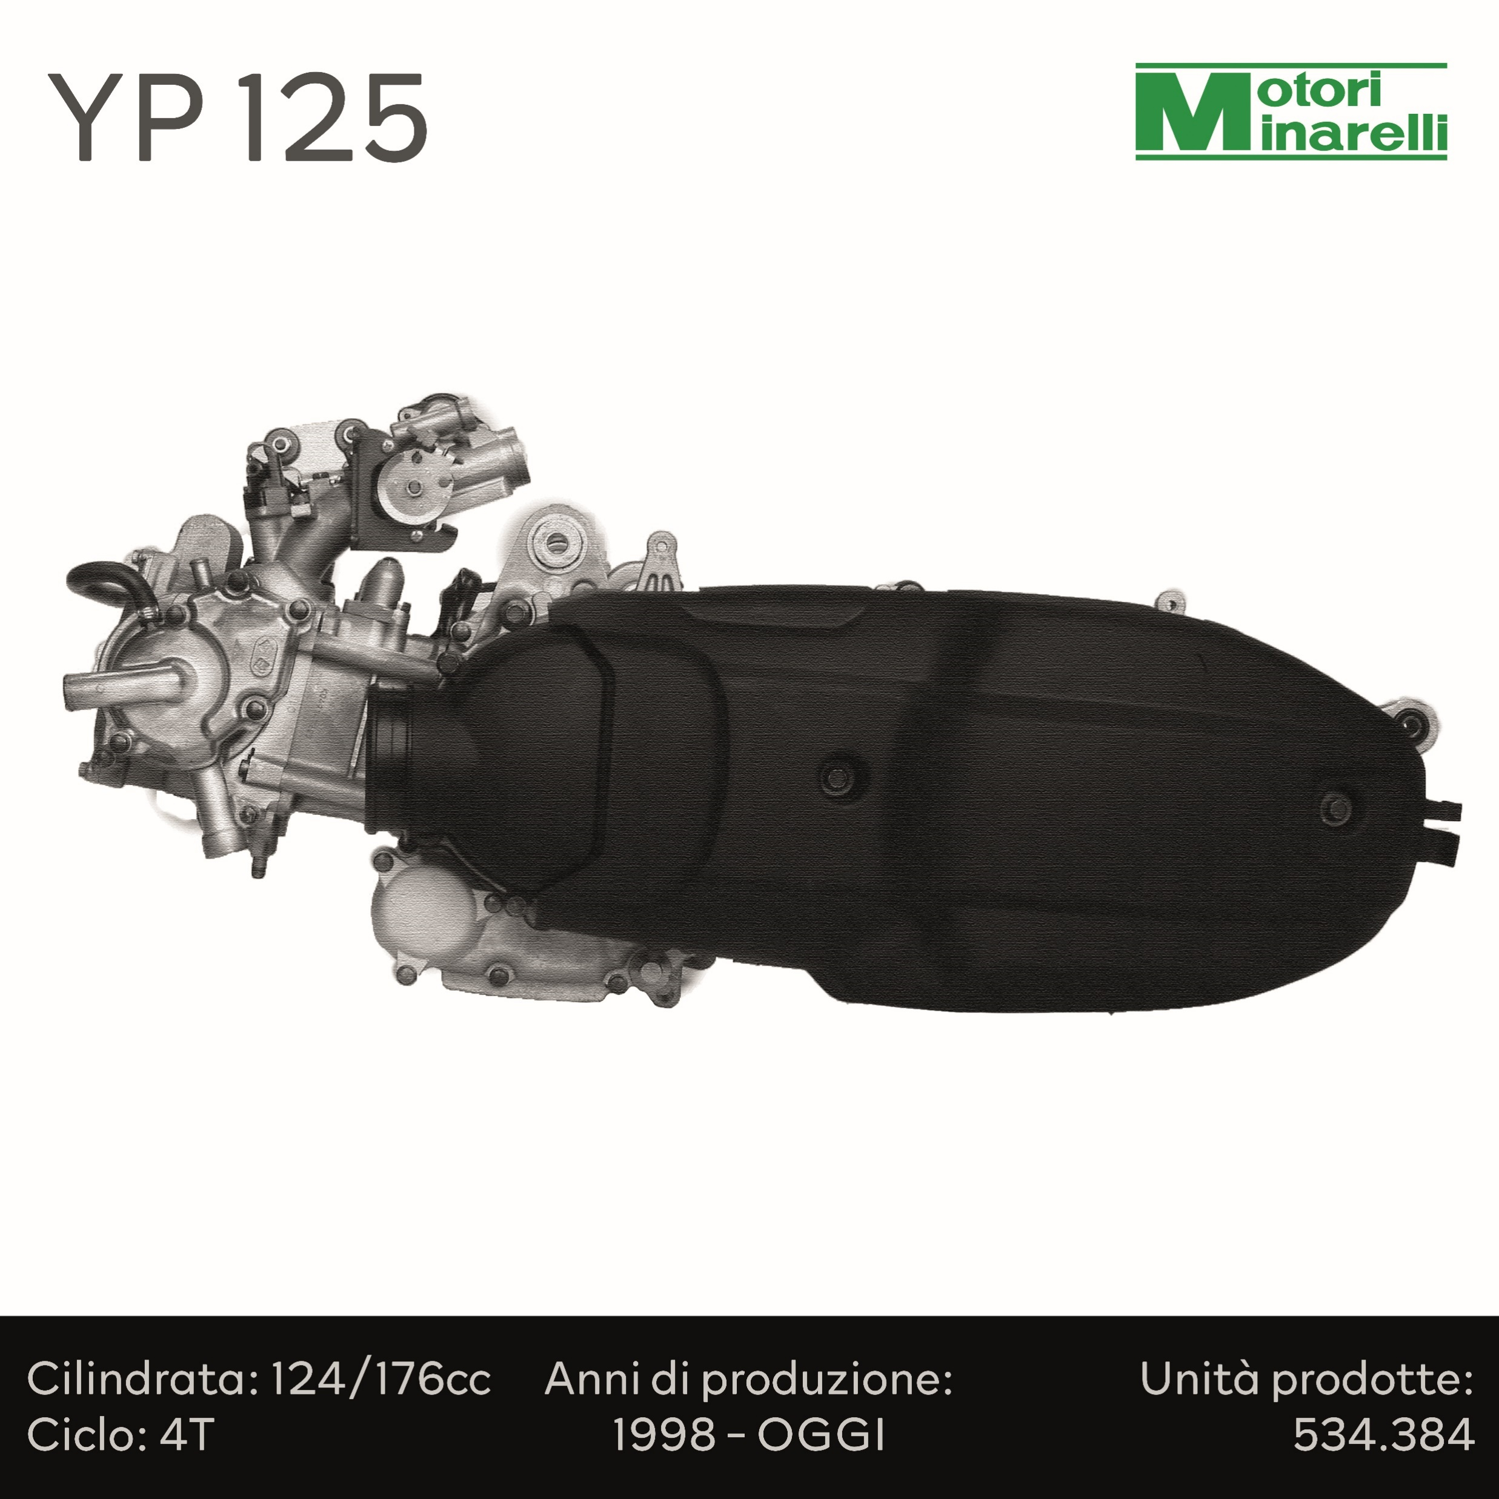
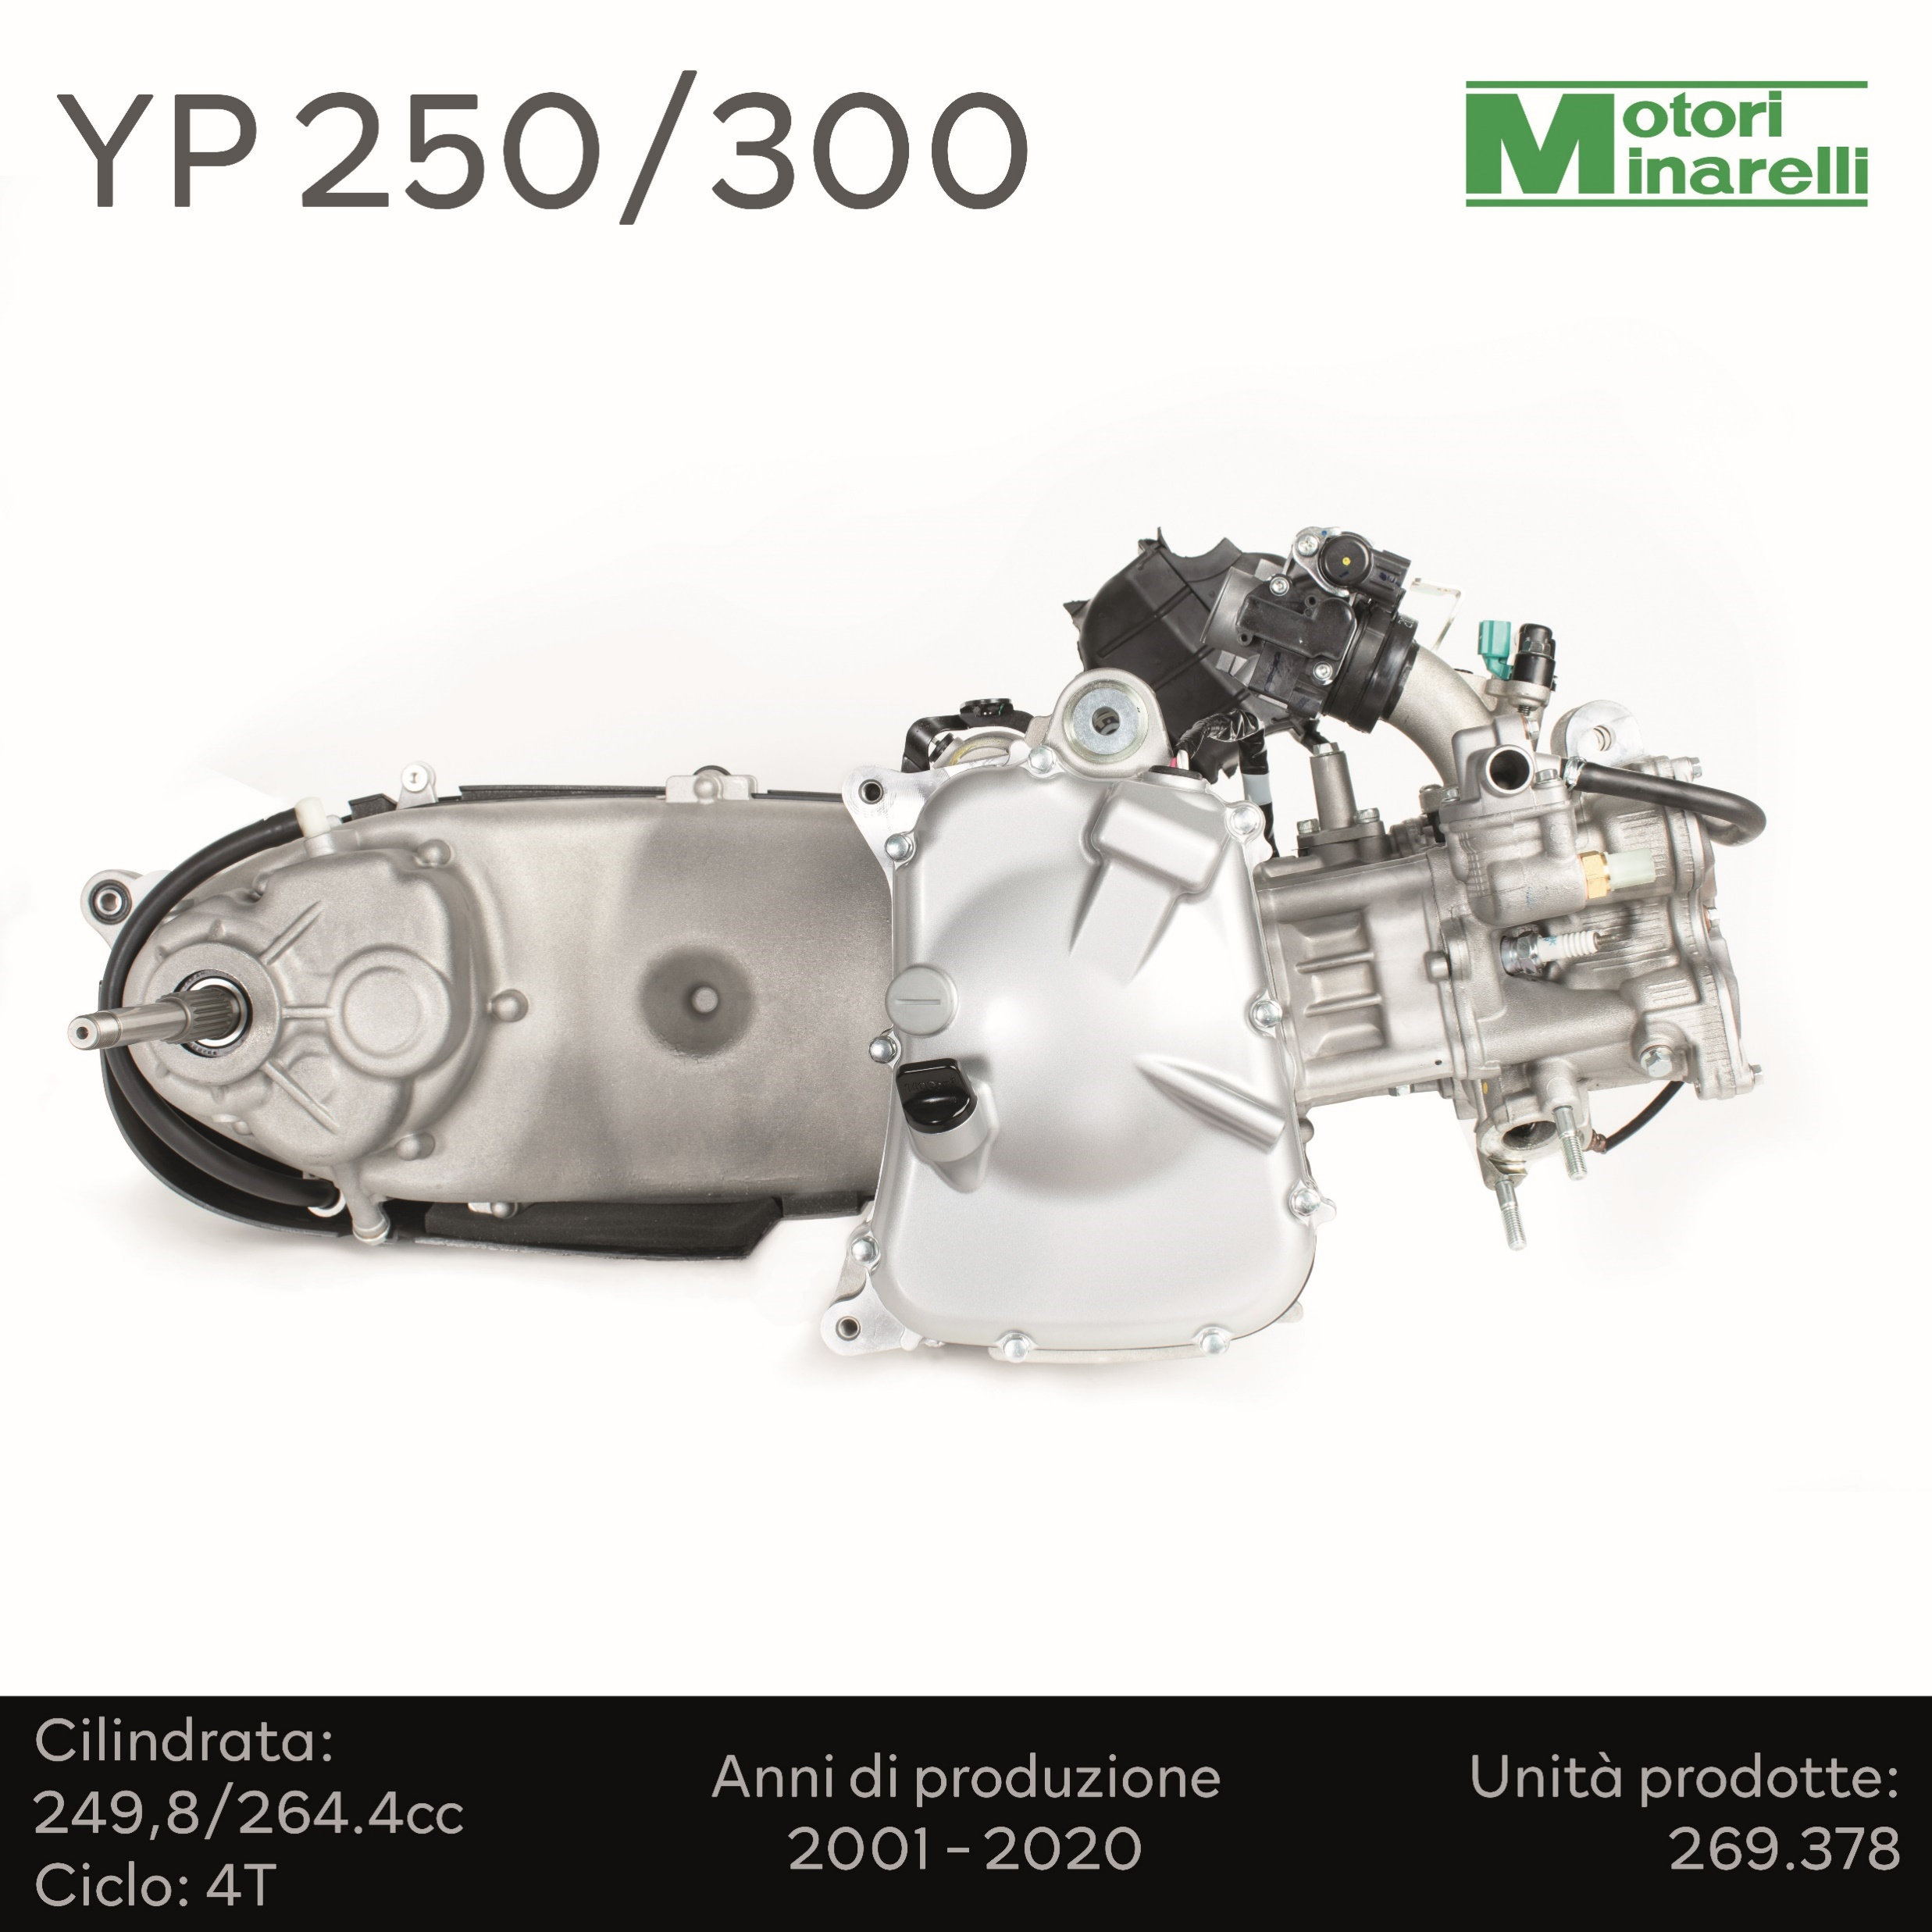
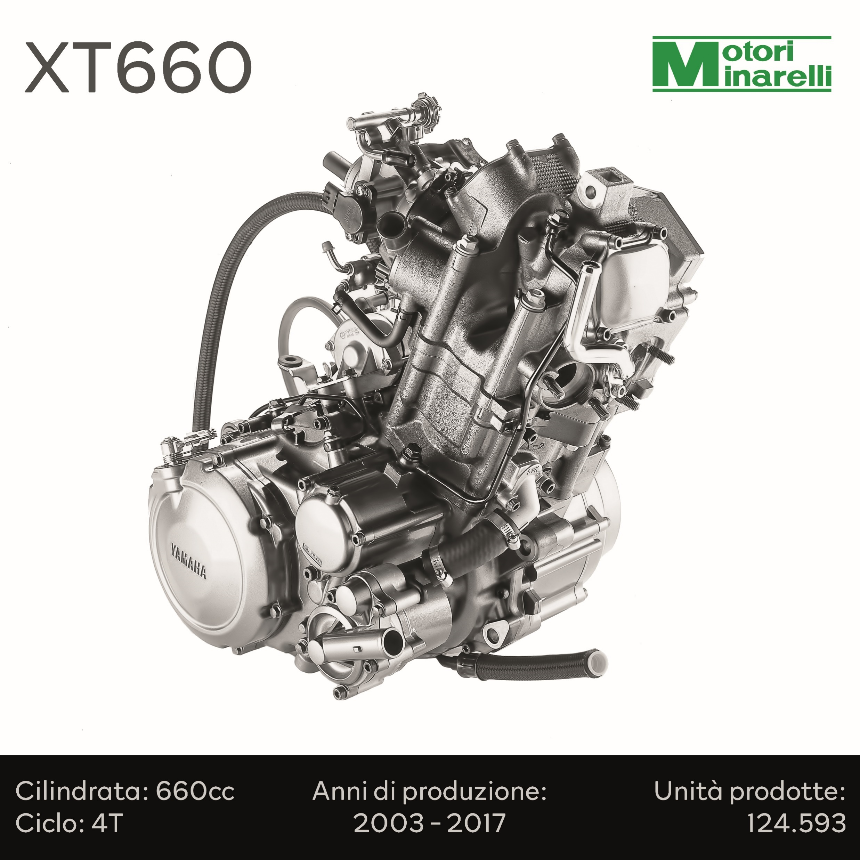
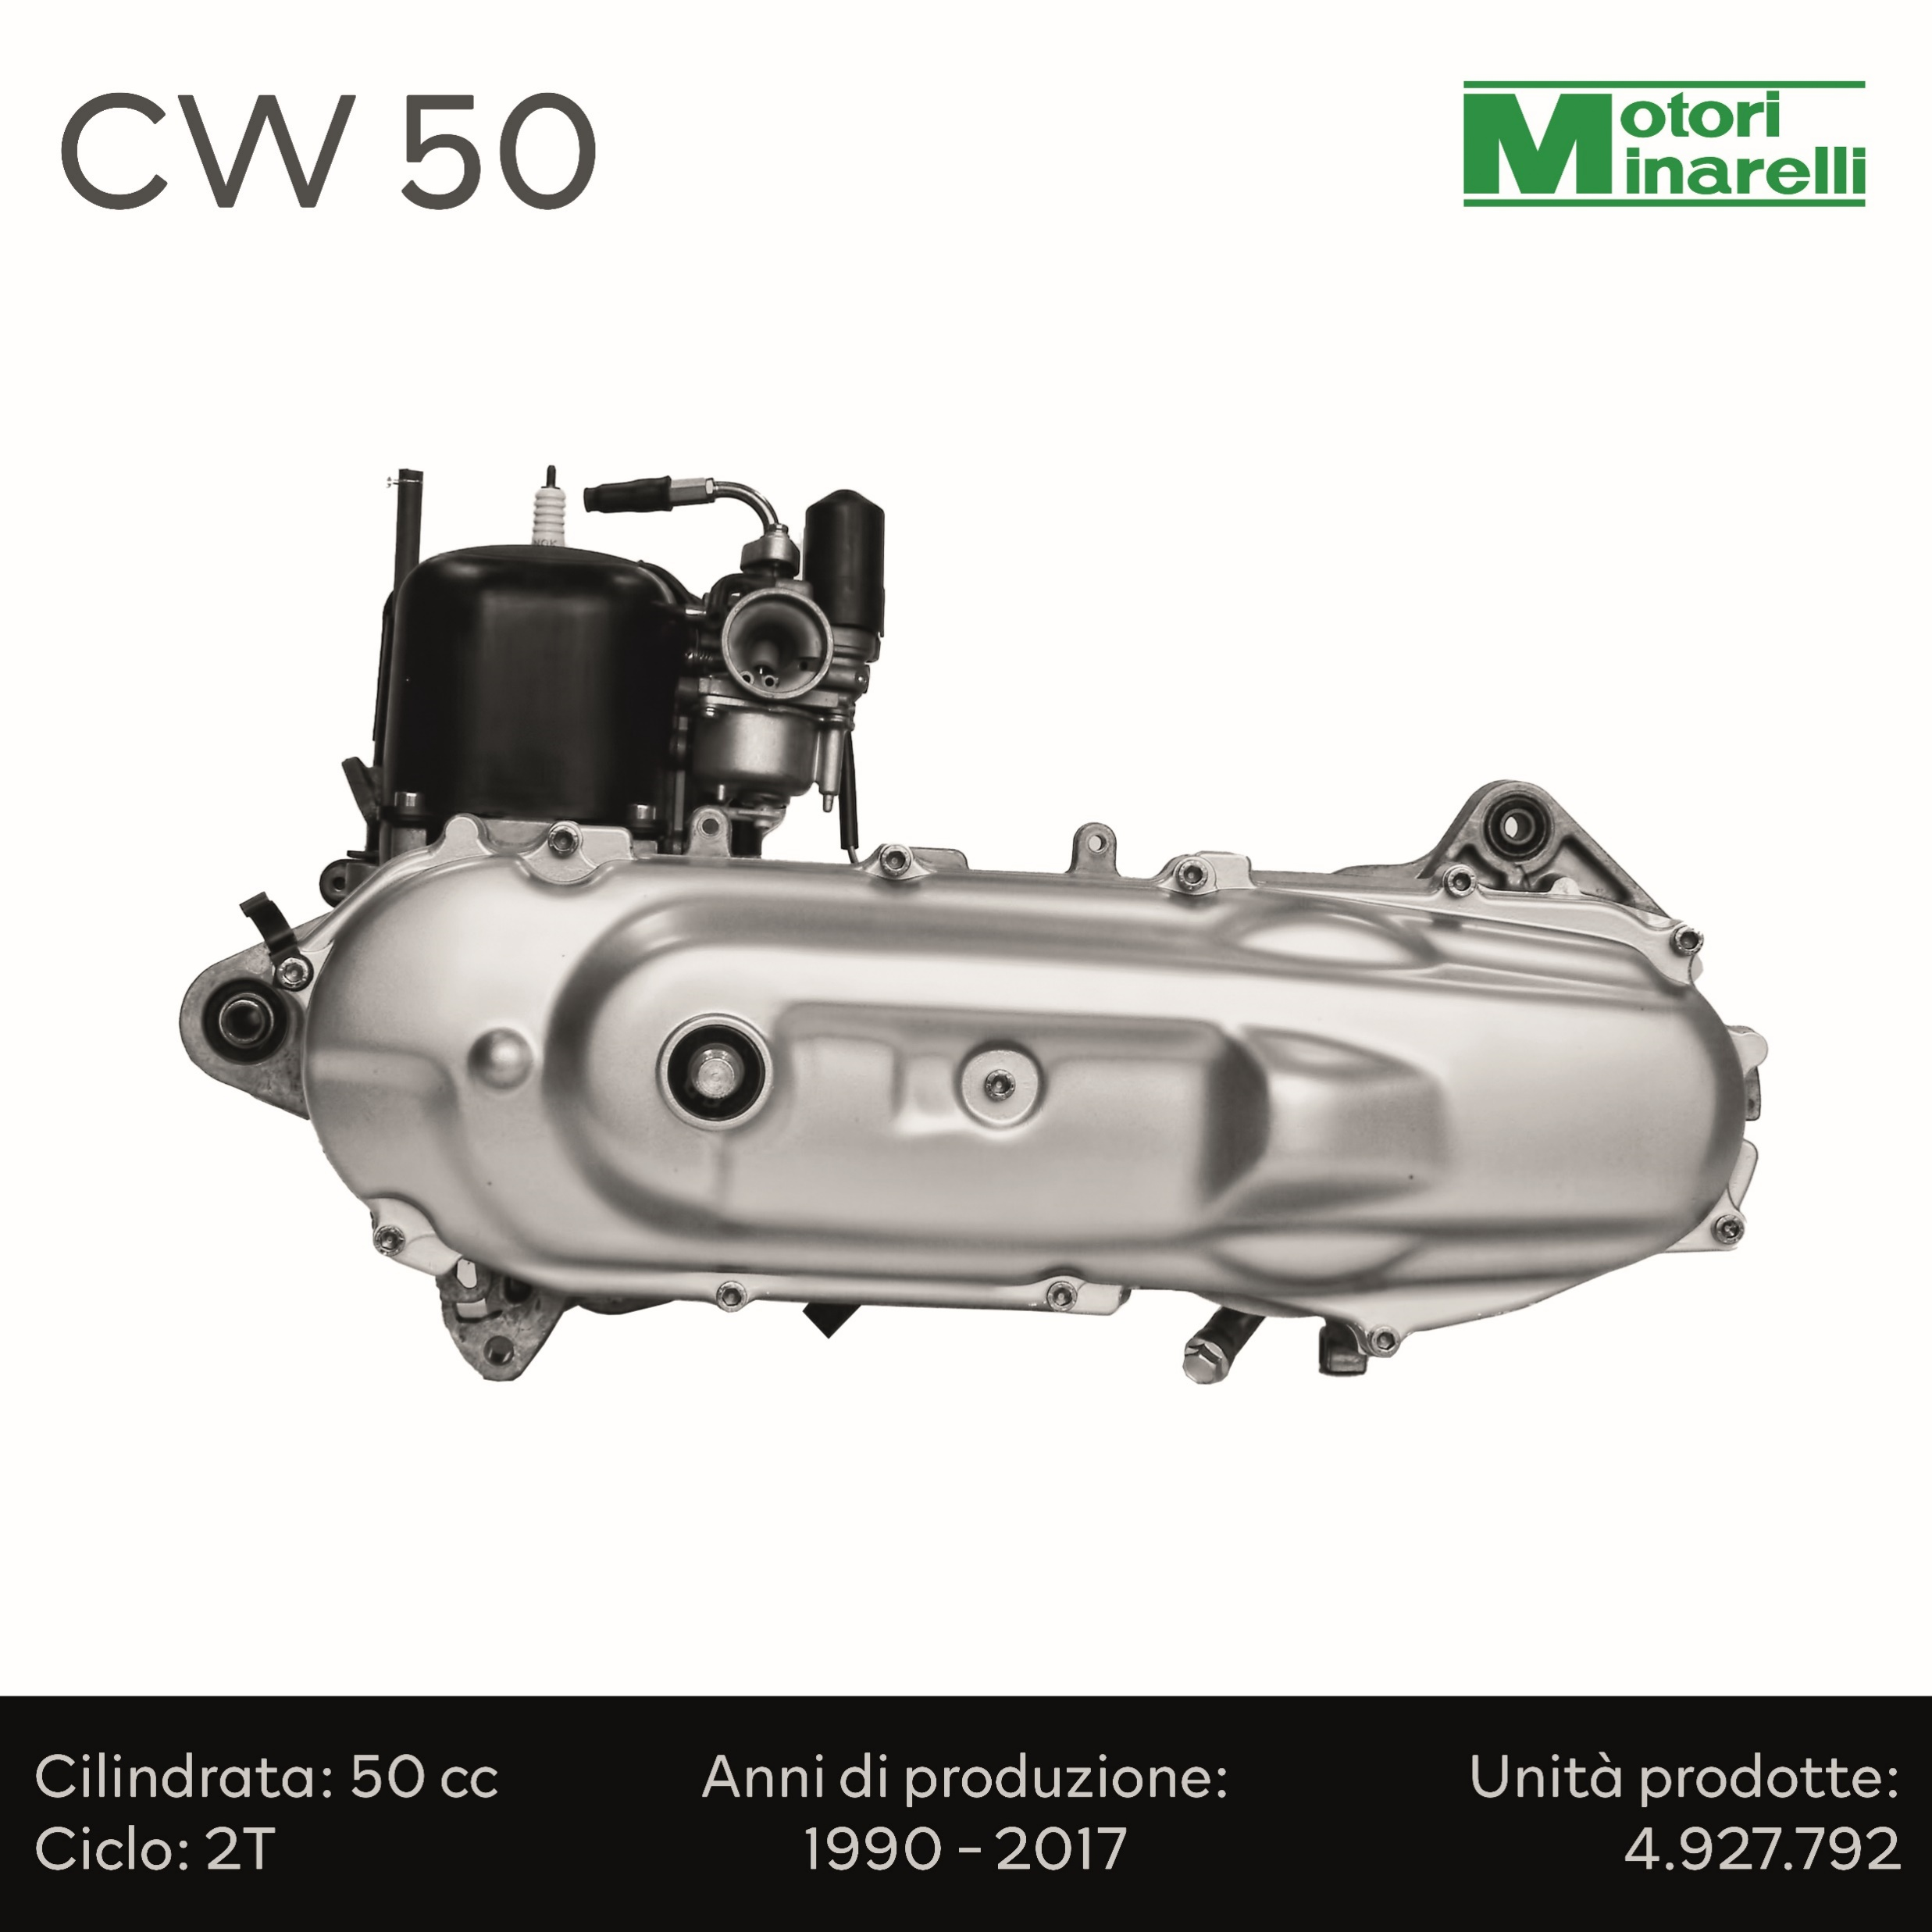
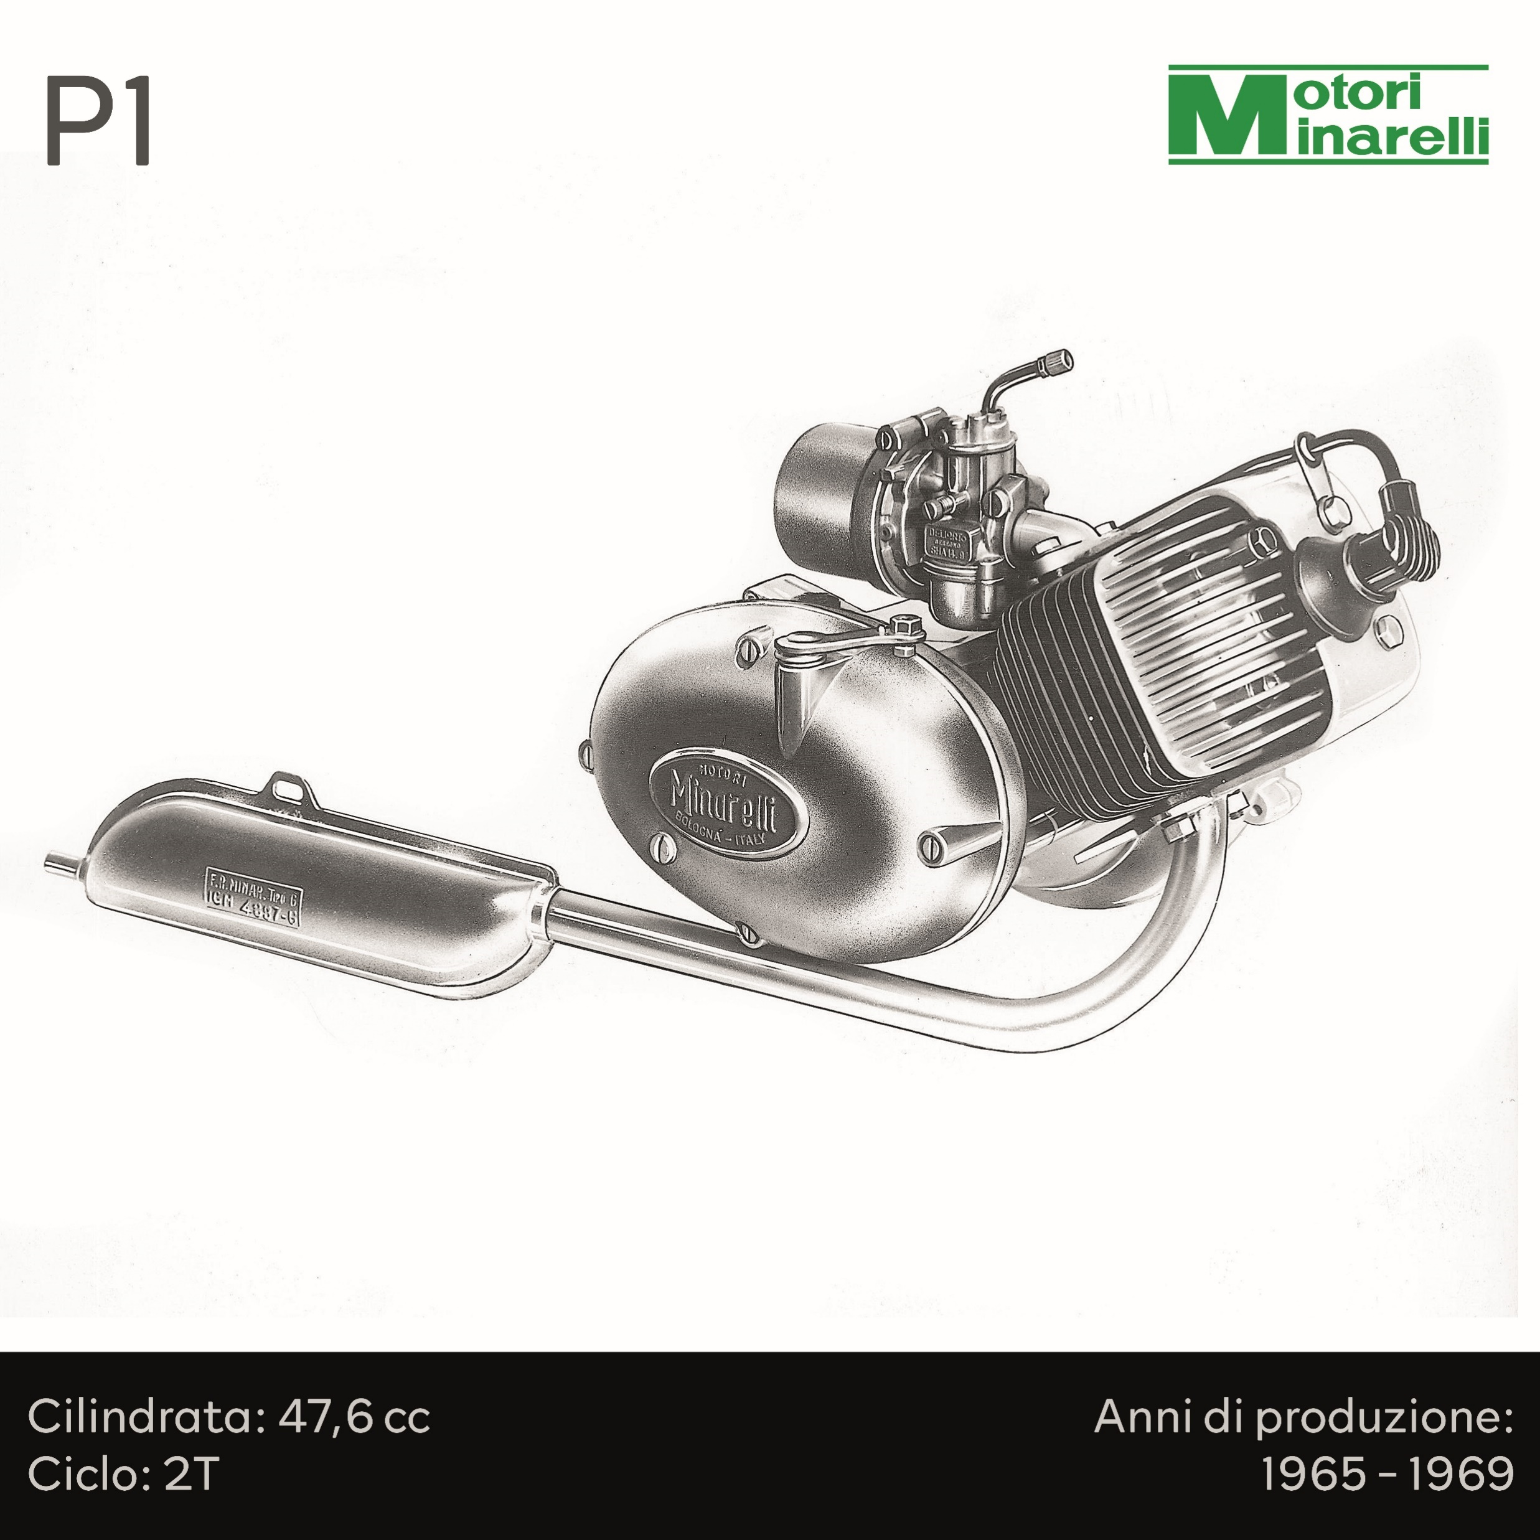
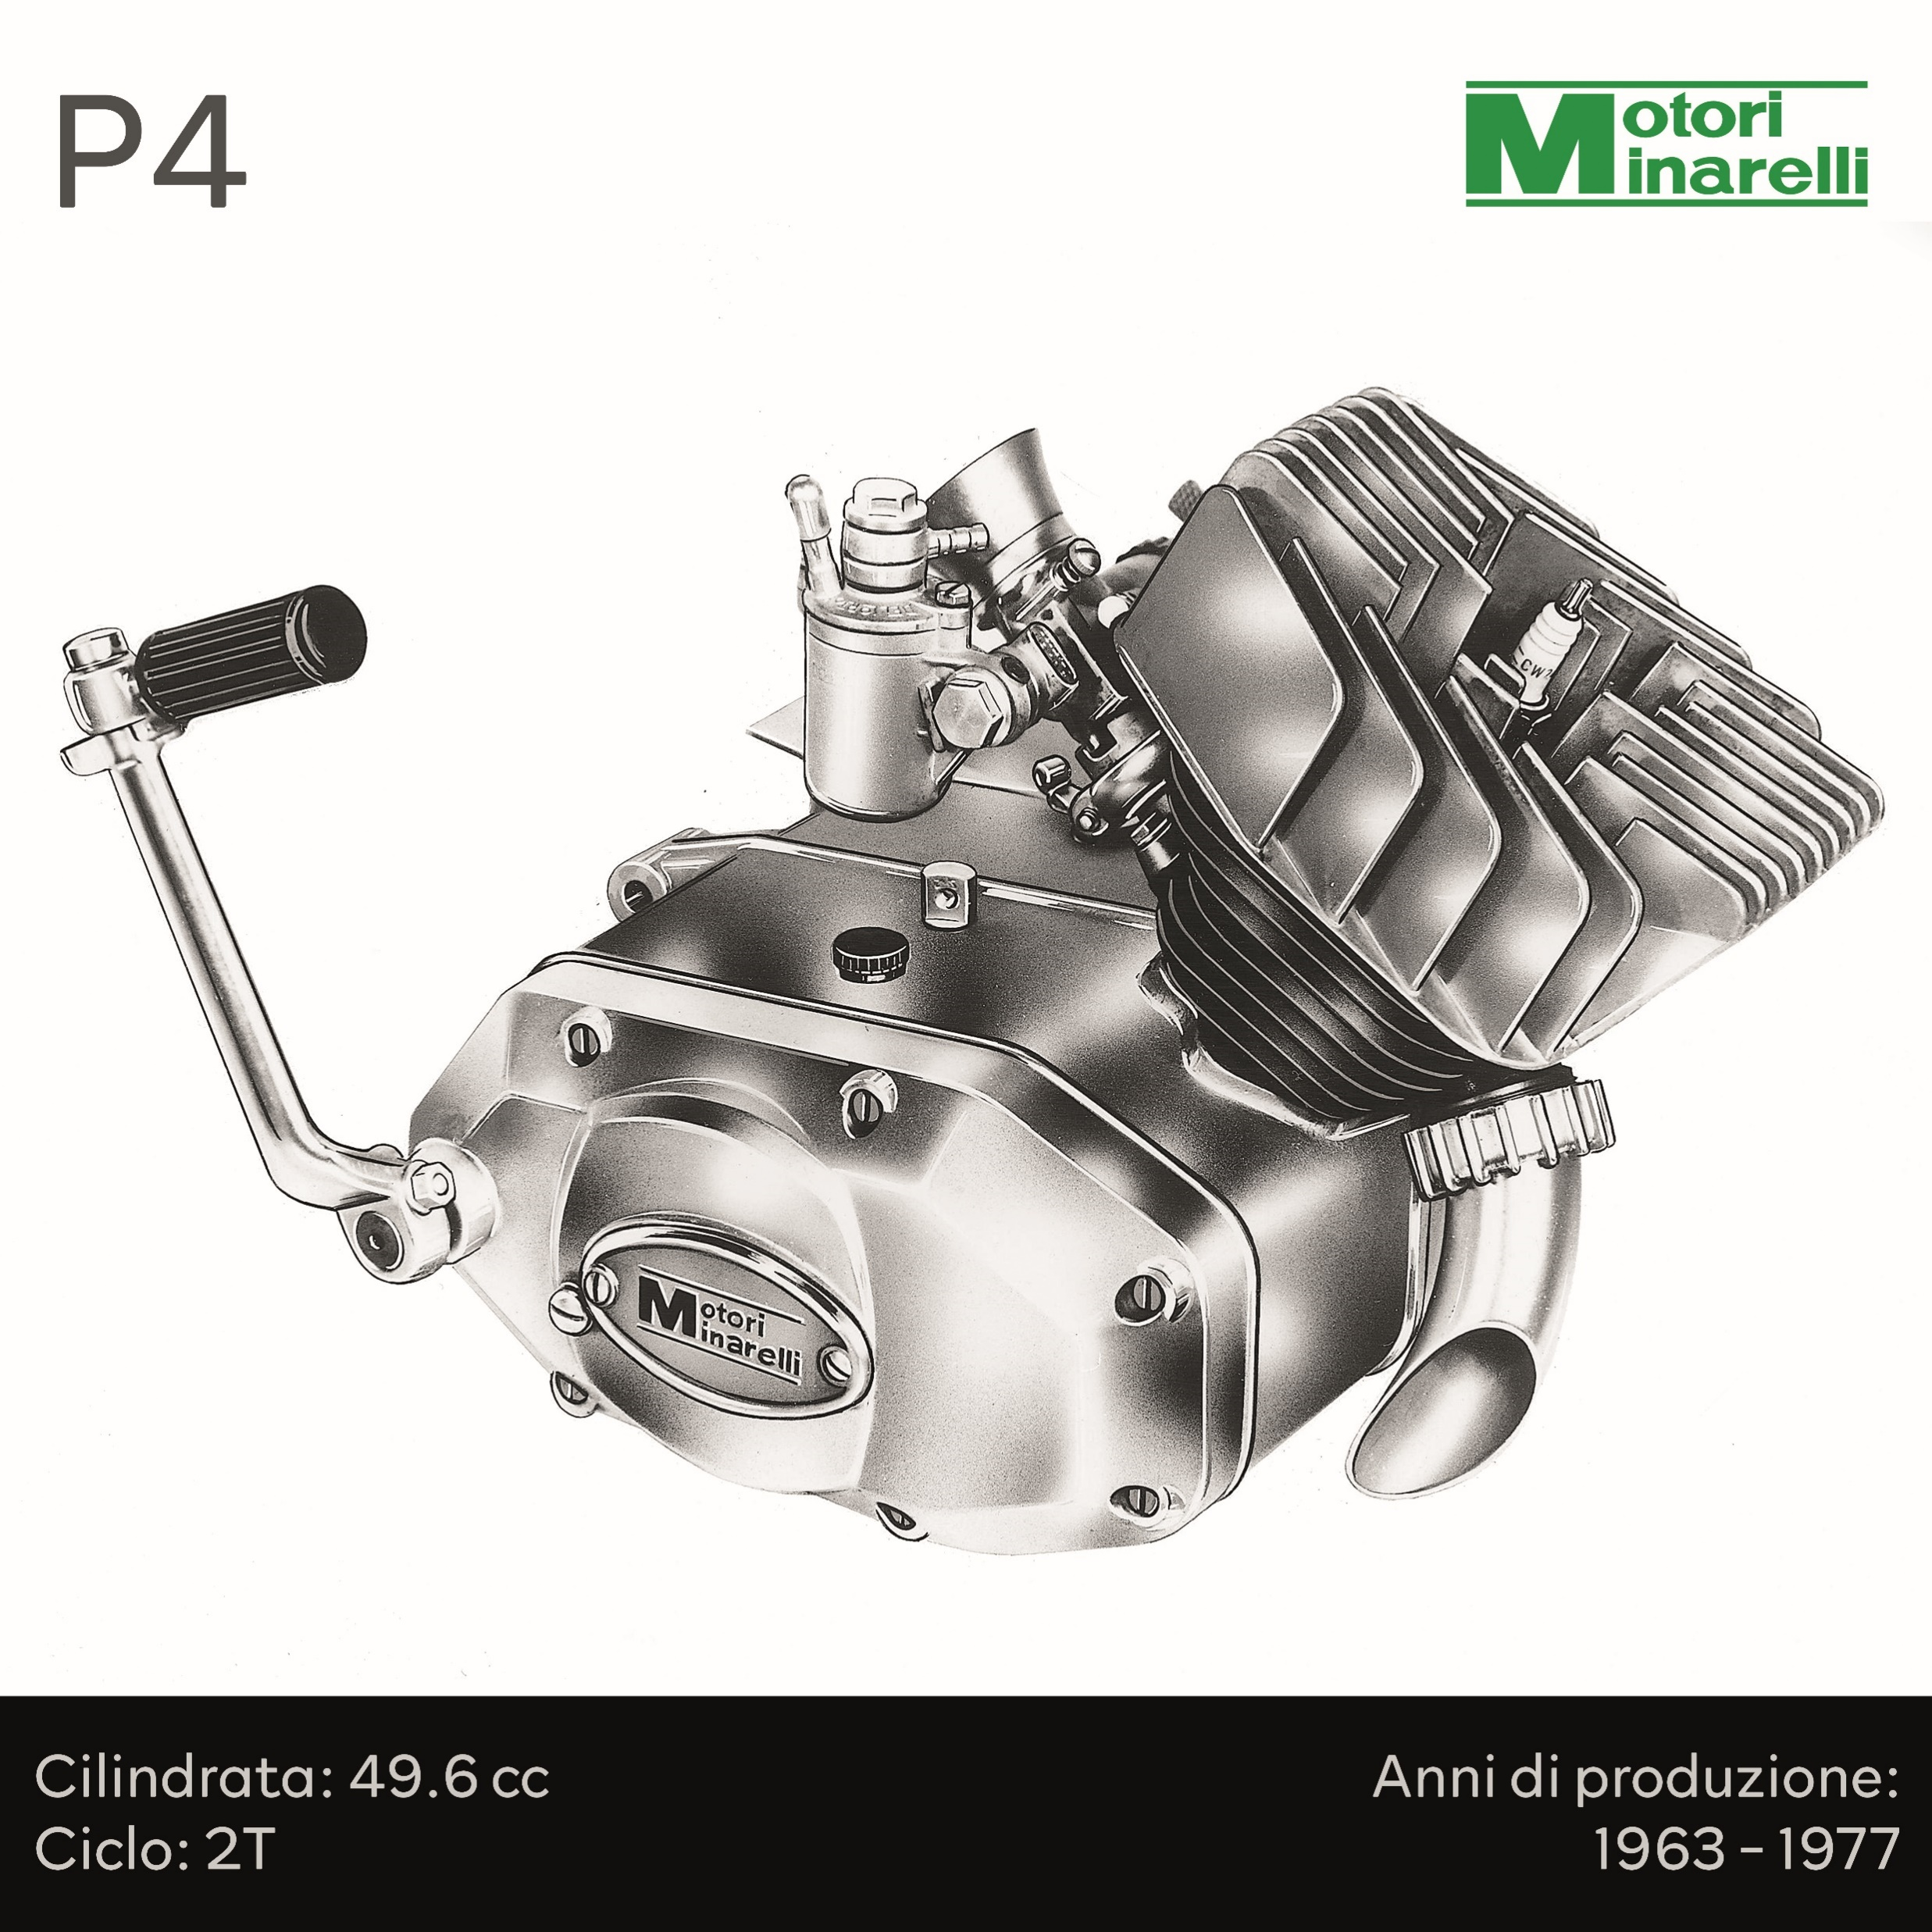
A company who wrote and will write the history of European 2 wheeler powertrain technology
Notes:
Voted by a European commission as the best Enduro e-bike of 2018

Slide 18
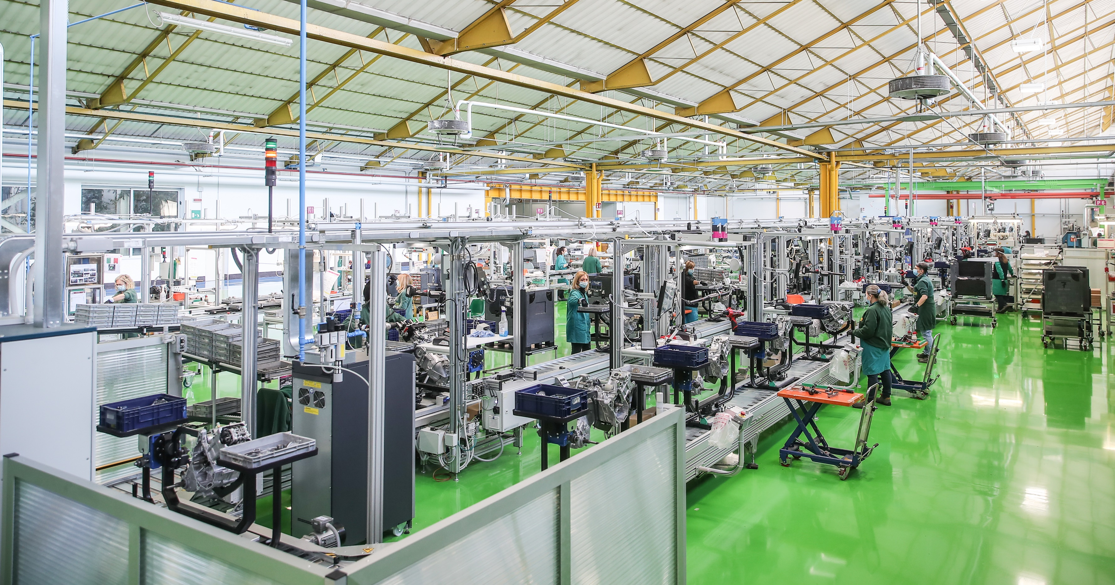
Best practice in engine assembling

Slide 19
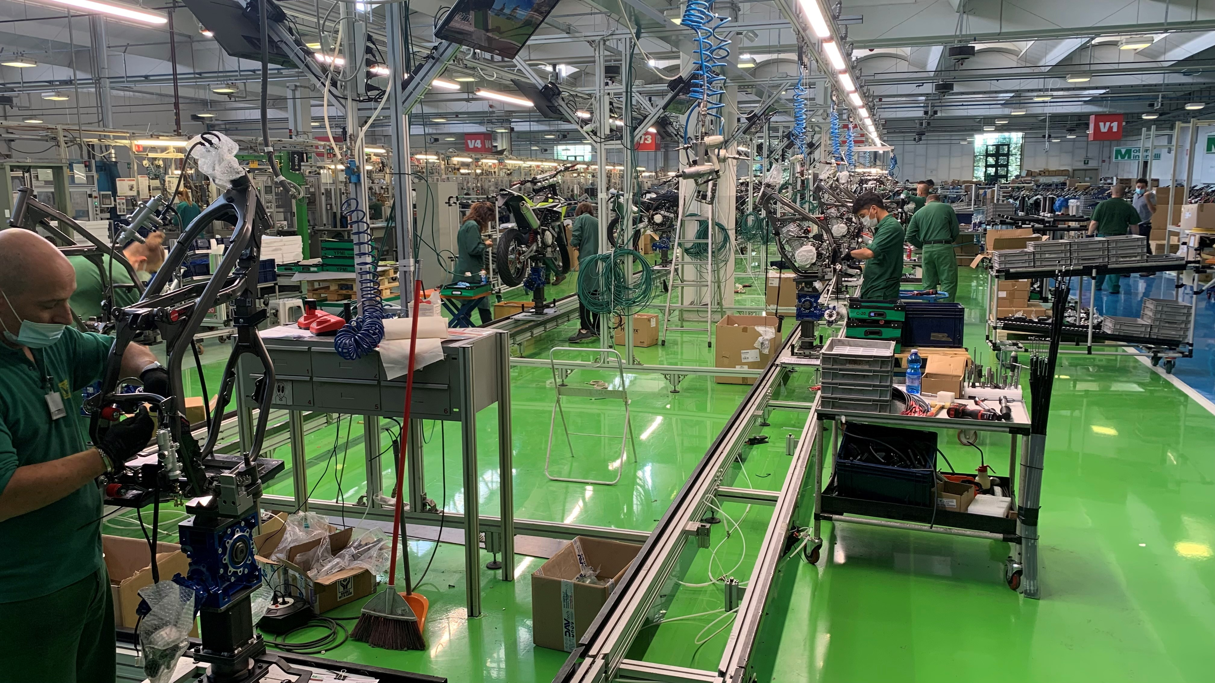
Since April 2021
vehicle manufacturing
150 motorcycle/day

Slide 20
BIKES
VIDEO
BIKES
MY23

Slide 21
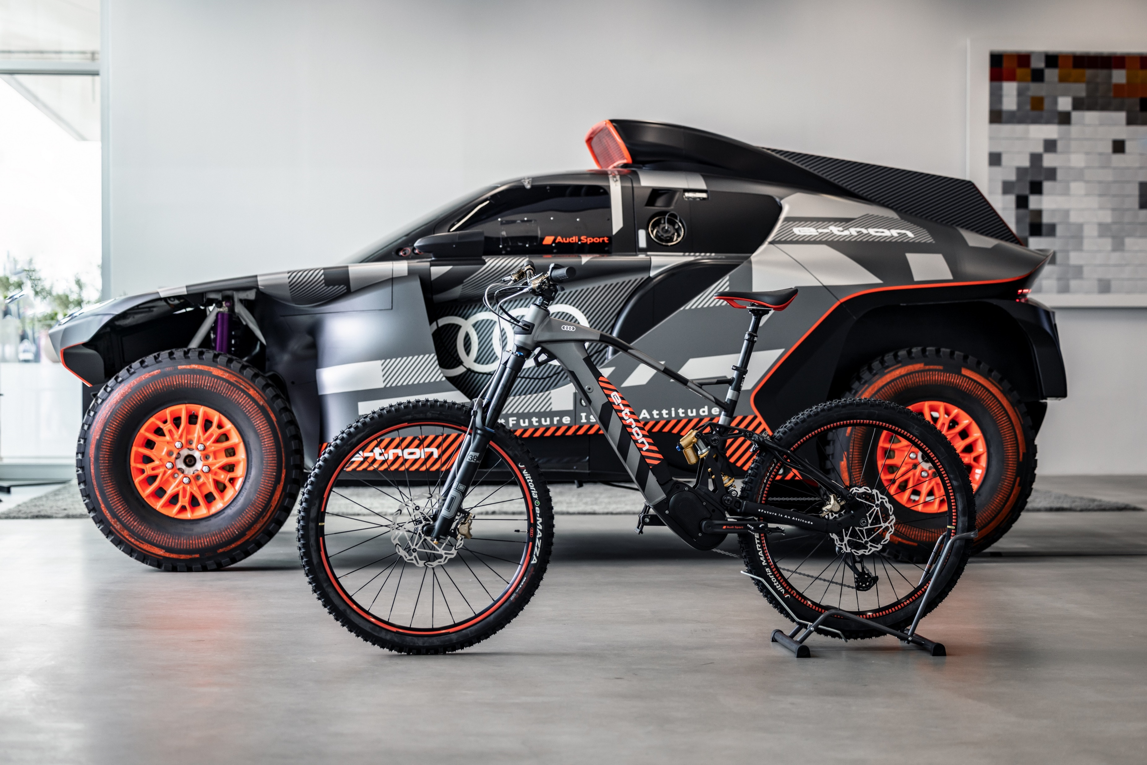
Partnership with AUDI

Slide 22
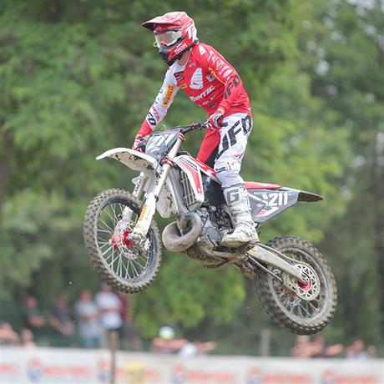
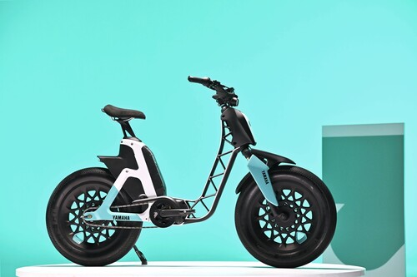
Partnership with Yamaha
Yamaha unveiled the new B01 vehicle in March 2022, which was entirely designed and developed by Fantic.
Today we are introducing you the new Fantic range powered by Yamaha
We have decided to reinforce our partnership with Yamaha in the bike world as we have been increasingly successful in the motorcycle enduro races.

